Slide 1
Anaesthesia for ENT and dental procedures
Dr S Spijkerman

Slide 2
Anaesthesia for adenotonsillectomy
Airway is shared with the surgeon
Risk of complications with Boyle-Davis mouth gag
Day case surgery – needs to be awake post-operatively
Painful procedure
Risk of post-operative bleeding
Risk of post-operative nausea and vomiting

Slide 3
Pre-operative management
Usual NPO guidelines apply – solids: >6h
- breast milk: >4h
- clear fluids: >2h
Pre-op evaluation: assess for obstructive sleep apnoea with pulmonary hypertension and right heart failure!
Premed: Paracetamol syrup with Tilidine drops OR
Paracetamol syrup with Midazolam po

Slide 4
Intra-operative management
Atropine prepared (not given routinely but MUST be prepared in case of bradycardia)
Suxamethonium prepared (not given routinely but MUST be prepared in case of laryngospasm)
Inhalation induction (mostly sevoflurane)
IV access (very NB – do not start without)
Opioid (sufentanil etc) and small dose propofol
Intubate with oral RAE tube (uncuffed if <4yr)
Throat pack
Muscle relaxants not routinely given in children

Slide 5
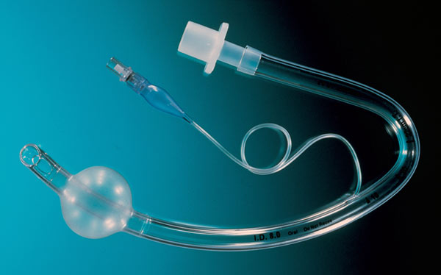
RAE oral tube (cuffed)

Slide 6
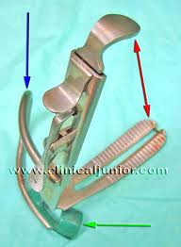
Boyle-Davis mouth gag
Trauma to lips, teeth, gums
Bradycardia if opened fast
Can occlude the RAE oral ETT
Breast plate can prevent chest expansion
and proper ventilation

Slide 7
After surgery:
Turn sevoflurane down
Remove throat pack
Inspect tonsillar beds for bleeding
Extubate awake
Place in recovery position (not head down – venous congestion)
Observe for bleeding in recovery room – excessive swallowing, vomiting of blood, overt bleeding
Post-op analgesia: paracetamol, Tilidine (not NSAID’s)

Slide 8
Post-tonsillectomy bleeding
Classification:
Primary: Bleeding within 24h of tonsillectomy (mostly due to haemostatic problem)
Secondary: Bleeding after 24h (mostly due to infection)
3 Main problems for the anaesthetist:
Hypovolaemia due to haemorrhage
Full stomach due to swallowed blood
Difficult airway (bleeding, swelling)

Slide 9
Management
Resuscitate (IV line, fluids, blood)
Emergency surgery
Possibilities for induction of anaesthesia:
 | Rapid sequence induction + cricoid pressure | Inhalation induction with cricoid pressure | Awake intubation
Advantages | Prevent aspiration | < chance of losing airway pt maintains spontaneous breathing | < chance of losing airway
Disadvantages | Might be unable to intubate after administration of suxamethonium | Chance of aspiration | Massive stress response may cause severe hypertension with intracerebral bleed
When indicated | When anaesthetist is experienced at intubation | Less experienced anaesthetist who might struggle to intubate a bleeding, swollen airway | Shocked pt with ↓ GCS

Slide 10
Rapid sequence induction
No NGT prior to induction – might dislodge clots on tonsillar bed and won’t suction clots from stomach
Surgeon ready in theatre to perform emergency tracheostomy
Good running IV line
2 well-functioning suction catheters
Ketamine and suxamethonium IV – intubate
Extubate wide awake when surgery complete

Slide 11
Inhalation induction
No NGT prior to induction – might dislodge clots on tonsillar bed and won’t suction clots from stomach
Surgeon ready in theatre to perform emergency tracheostomy
IV access if at all possible
Pt on side, slightly head down
Maintain cricoid pressure
2 well-functioning suction catheters
Sevoflurane →IV line if not yet in → inspection → intubate or give suxamethonium if able to visualise vocal cords and then intubate
Extubate wide awake when surgery complete

Slide 12
Dental surgery
Day case surgery (short-acting drugs)
Shared airway (surgeon and anaesthetist)
Dental surgeons use lignocaine with adrenaline (1:80 000) for nerve blockade and haemostasis before procedures. The added adrenaline potentiates the dysrhythomogenic effect of halothane and causes tachycardia
RAE nasal tube is most often used
Use half a size smaller for nasal intubation
Magill forceps used to guide ETT through vocal cords
Heat the tube in hot water prior to insertion to soften the tip – decreases trauma to nostrils (Don’t burn the pt!!)
Throat pack used – remove after surgery!

Slide 13
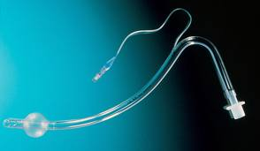
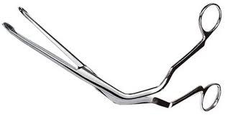
RAE nasal tube and Magill forceps

