Slide 1
Antihypertensives
Dr Thabo Makgabo

Slide 2
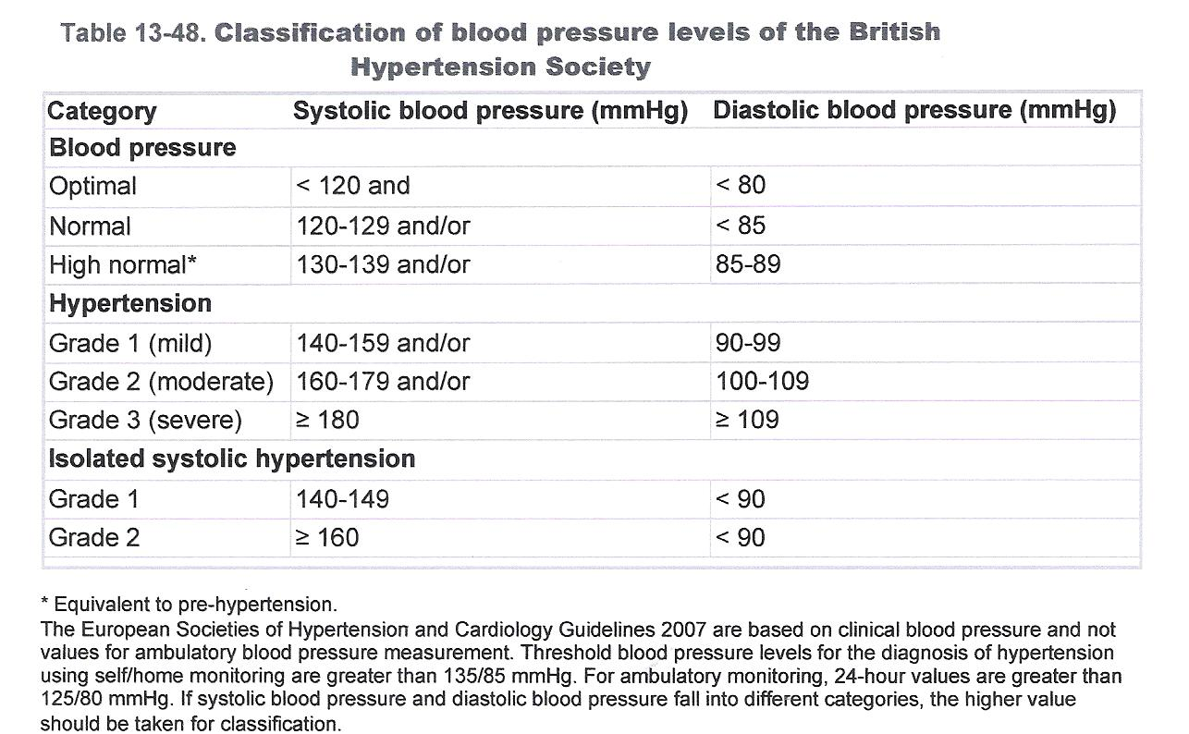
Hypertension

Slide 3
Antihypertensives
3 classes of antihypertensive agents for the management of persons without compelling indications- 1st line drugs
Diuretics (thiazide-like and thiazide)
Angiotensin-converting enzyme inhibitors (ACE-Is)
Calcium channel blockers (CCBs)
If control is not reached with monotherapy,combination therapy should be instituted with another drug from the first-line classes.
The others
Angiotensin-receptor blockers
Aldosterone-receptor antagonists
Beta blockers
Direct acting vasodilators
Drugs that alter sympathetic nervous system

Slide 4
Antihypertensives with concomitant diseases

Slide 5
Diuretics
Thiazide diuretics
The low-dose thiazide or thiazide-like diuretics (e.g. indapamide, hydrochlorothiazide) are first-line therapy for mild to moderate hypertension, especially in black patients and the elderly
Loop diuretics
(furosemide)
Reduced glomerular filtration rate or by volume overload.
Potassium-sparing diuretics
To reduce the loss of potassium when they are used with thiazides
Amiloride, an epithelial sodium-channel blocker, is reportedly more effective than spironolactone as therapy in blacks who have resistance to treatment.

Slide 6
Calcium Channel Blockers
Dihydropyridine
Examples
Amlodipine
Nifedipine
Isradipine
Felodipine
Lercanidipine
Greatest vasodilatory effect -predominately on the vascular smooth muscle and have minimal effects on nodal conduction
Non-dihydropyridine
Examples
Verapamil
Diltiazem
Prominent depressant effects on the nodes and can therefore be used to treat supraventricular arrhythmias.

Slide 7
ACEis
Class I: Captopril-like
Captopril
Class II: Prodrugs
Enalapril
Perindopril
Quinapril
Ramipril
Trandolapril
Class III: Water-soluble
Lisinopril

Slide 8
Adverse effects
Severe hypotension – 1st dose hypotension
Teratogenic
Chronic dry cough sometimes accompanied by wheezing
↑K+
Angioedema.

Slide 9
Angiotensin-receptor blockers
Angiotensin II type 1 (AT1) receptor blockers
Examples
Losartan
Valsartan
Candesartan
Irbesartan
Telmisartan
In clinical practice, ARBs should be used to treat patients who are ACE intolerant due to intractable cough or who develop angioedema

Slide 10
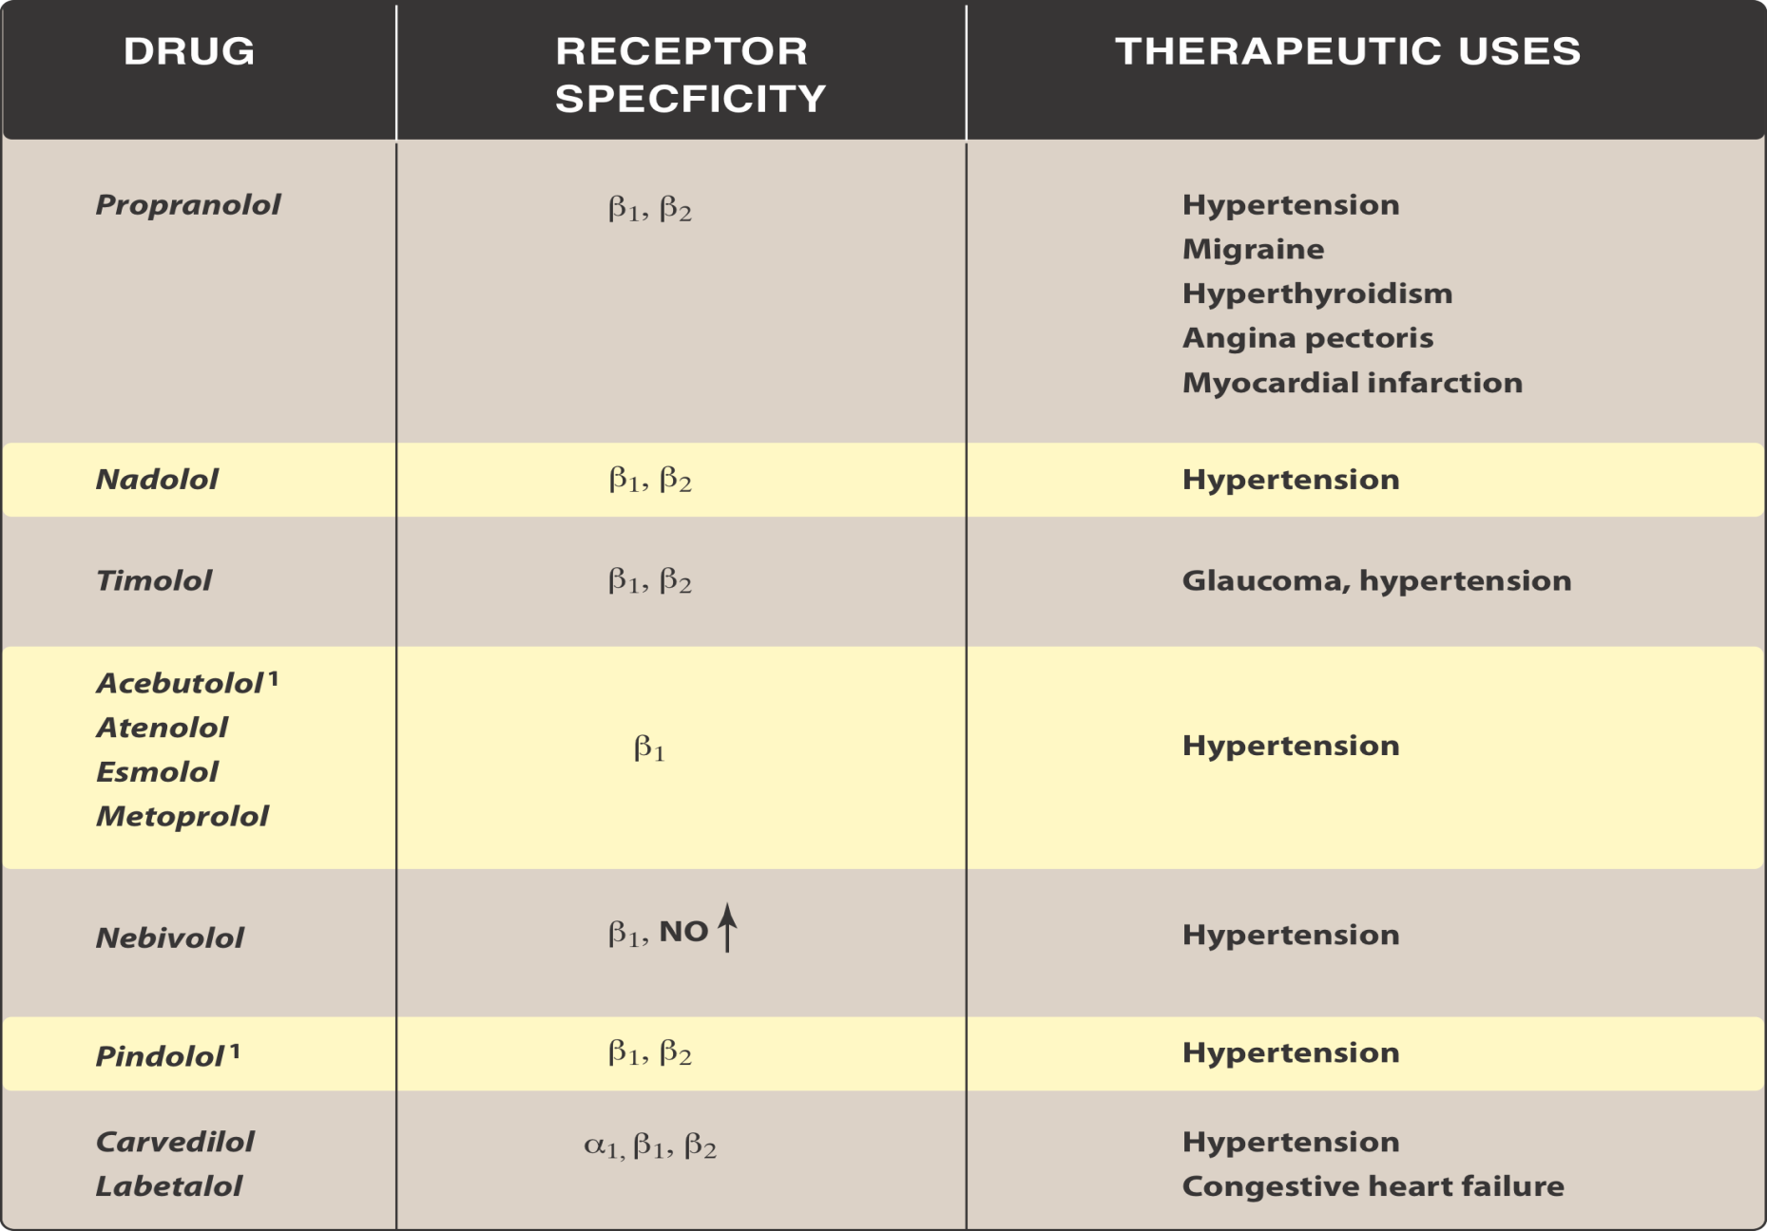
Beta blockers

Slide 11
Indications and contraindications for diuretic use
 | Conditions favouring use | Compelling contraindications | Possible contraindications
Diuretics (thiazide ) | HF Elderly hypertensives ISH Hypertensives of African origin | Gout | Pregnancy β –blockers(especially atenolol)
Diuretics (loop) | Renal insufficiency HF |  | Pregnancy
Diuretic (anti-aldosterone) | HF Post MI Resistant hypertension | Renal failure Hyperkalaemia

Slide 12
Indications and contraindications for CCB use
 | Conditions favouring use | Compelling contraindications | Possible contraindications
CCB-Long acting only (dihydropyridine) | Elderly patients ISH Angina pectoris Peripheral vascular disease Carotid atherosclerosis Pregnancy(nifedipine only) |  | Tachyarrhythmias HF
Non-dihydropyridine CCB(verapamil, diltiazem) | Angina pectoris Carotid atherosclerosis SVT | AV block (grade 2 or 3) HF | Constipation (verapamil)

Slide 13
Indications and contraindications for ACEis and ARBs use
 | Conditions favouring use | Compelling contraindications | Possible contraindications
ACEis | HF LV dysfunction Post MI Non-diabetic nephropathy Type 1 nephropathy Proteinuria Prevention of diabetic microalbuminuria | Pregnancy Hyperkalaemia Bilateral renal artery stenosis Angioneurotic oedema(more common in blacks than whites)
ARBs | Type-2 diabetic nephropathy Type-2 diabetic microalbuminuria LVH ACEi cough or intolerance | Pregnancy Hyperkalaemia Bilateral renal artery stenosis

Slide 14
Indications and contraindications for beta blockers use
 | Conditions favouring use | Compelling contraindications | Possible contraindications
Beta blockers | Angina pectoris Post MI HF(selected) Tachyarryhthmias | Asthma Chronic osbstructive pulmonary disease AV block (grade 2 or 30 Pregnancy (atenolol) | Peripheral vascular disease Bradycardia Glucose intolerance Metabolic syndrome Athletes and physically active people

Slide 15
Other anti hypertensives
Direct vasodilators
hydralazine and minoxidil
Centrally acting drugs
α-methyldopa (α2-blocker)
moxonidine
α1-blockers
Doxazosin
Ganglion blockers
Guanethidine

Slide 16
Direct acting vasodilators
Direct vasodilators can be divided into:
Hydrazinophthalazine derivates e.g. Hydralazine, Dihydralazine
Pyrimidine derivatives e.g. Minoxidil
Nitroferricyanide derivatives e.g. Sodium nitroprusside

Slide 17
Hydralazine
Used in hypertensive crisis in pregnancy
Adverse effects:
Headache,
Nausea, anorexia,
Tachycardia,palpitations (beta blockers often combined to counteract tachycardia)

Slide 18
Sodium Nitroprusside
Used in hypertensive crisis
Adverse effects
Headache,palpitation,tachycardia
Accumulation of cyanide→ cyanide toxicity,arrhythmias and death
Sodium thiosulphate is given for prophylaxis or treatment of cyanide poisoning during nitroprusside infusion.

Slide 19
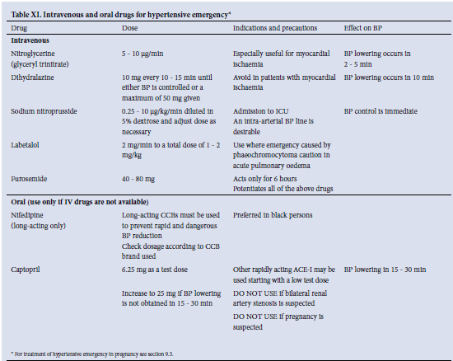
Hypertensive emergency

Slide 20
Hypertension in Pregnancy
Diuretics and atenolol should generally be avoided, and ACE-Is and ARBs are contraindicated entirely.
Suitable antihypertensive drugs to be used in pregnancy are:
Methyldopa
Nifedipine XL
Apresoline
Labetalol – hypertensive crisis
Hydralazine- hypertensive crisis

Slide 21
New Treatments and New Targets
Now the first direct renin inhibitor (DRI) for clinical use (aliskiren) has emerged.
Can be combined with other antihypertensives , such as diuretics, ACEi, ARBs, and CCBs.

Slide 22
In summary
1st three drugs given
Diuretics
ACEi /ARBs
CCBs
4th drug
α blocker
β blocker
Aldosterone antagonist
Centrally acting drugs
Direct vasodilators

Slide 23
Questions ??

