Slide 1
Connective tissue diseases
Professor W K Jacyk

Slide 2
Connective tissue diseases
Lupus erythematosus
Scleroderma
Dermatomyositis
Overlap syndromes
Mixed connective tissue disease

Slide 3
Lupus Erythematosus
Chronic cutaneous Lupus Erythematosus (discoid LE)
Only cutaneous involvement
Systemic LE- involvement of internal organs
Subacute Cutaneous LE

Slide 4
dLE
SCLE
SLE
Different disease sharing similar pathology or a spectrum?

Slide 5
Chronic cutaneous LE
Localised – usually sun-exposed areas only
Disseminated
Most often women
Skin lesions from mild to severely disfiguring
Scarring alopecia- African women
Gets worse after sun exposure
Only very seldom dLE transforms into SLE, but discoid lesions are not uncommon in SLE

Slide 6
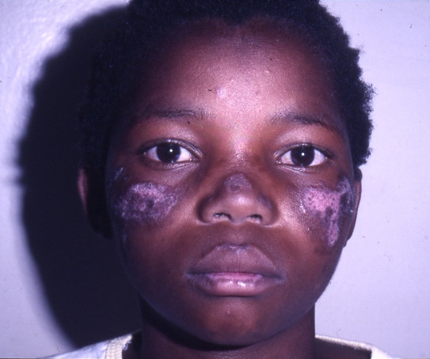

Slide 7
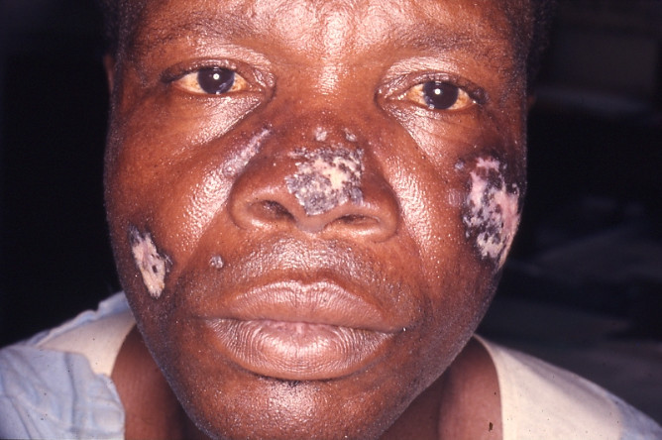

Slide 8
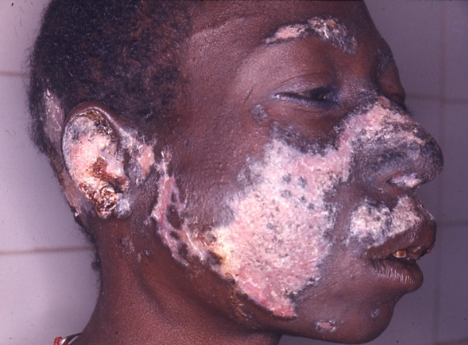

Slide 9
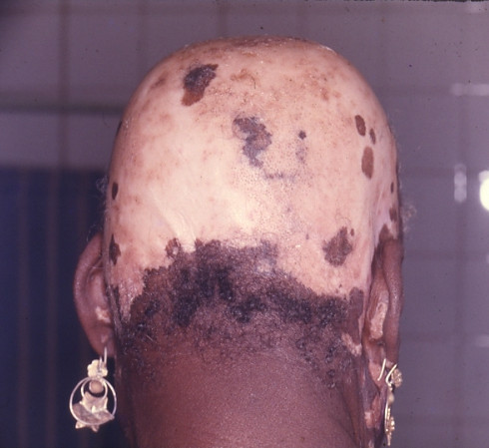

Slide 10
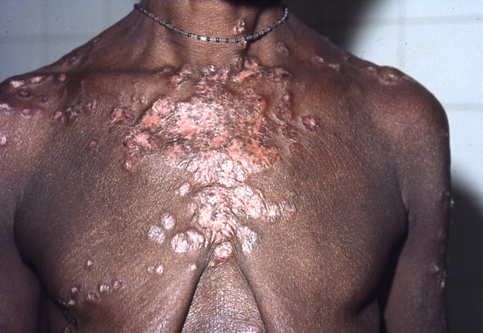

Slide 11
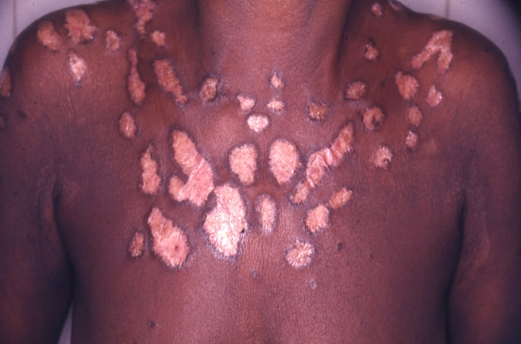

Slide 12
Treatment
Sun protection
Oral antimalarials- chloroquine, quinacrine
Topical corticosteroids
Systemic corticosteroids
Immunosuppressors – Azathioprine
Oral gold
Start treatment early to avoid destruction
Cover up for disfigured lesions

Slide 13
Systemic LE
2/3rd women, more common in African patients
Genetic background- link with some HLA and complement component deficiencies
Triggering factors
Ultra-violet
Viruses
Medications- anticonvulsives, isoniazid, minocycline, procainamide

Slide 14
ARA criteria for diagnosis
4 out of 11
Cutaneous – malar(butterfly)rash
- discoid lesions
- photosensitivity
- oral ulcers
Systemic - renal
- serositis
- neuropsychiatric
- arthritis
- haematologic – haemolytic anemia,
leucopaenia, thrombocytopaenia
Laboratory – False+ VDRL
- positivity ANA, ds-DNA, SM, Ro, La, etc.

Slide 15
Skin lesions in SLE
Except those discoid lesions, fleeting, superficial
Variable
Butterfly (malar) rash
Erythema on exposed areas
Urticarial
Swellings
Blisters
Purpura
Vasculitic – fingers
Subcutaneous nodules
Loss of hair
Oral ulcers

Slide 16
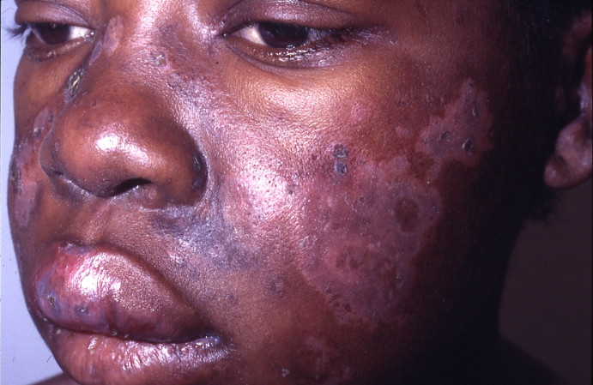

Slide 17
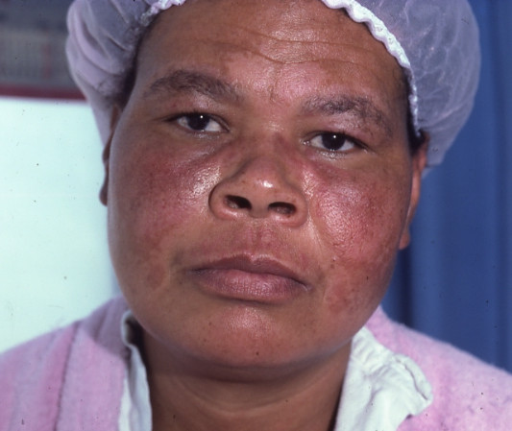

Slide 18
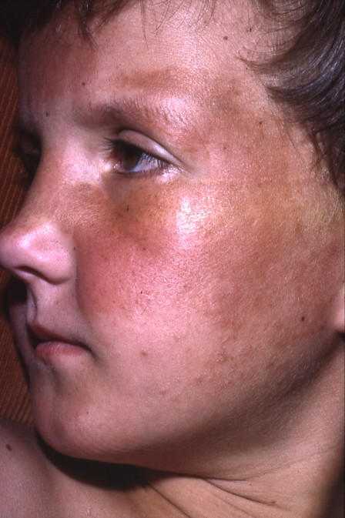

Slide 19
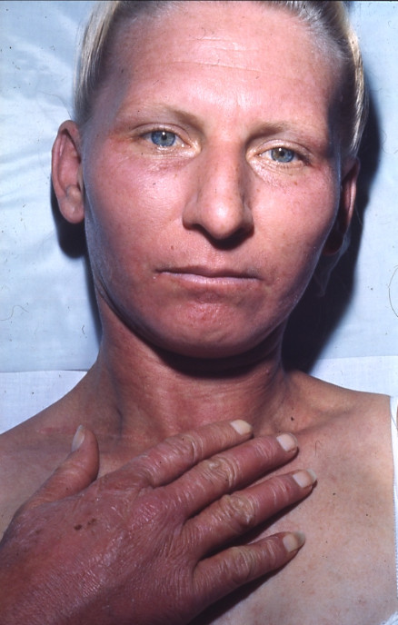

Slide 20
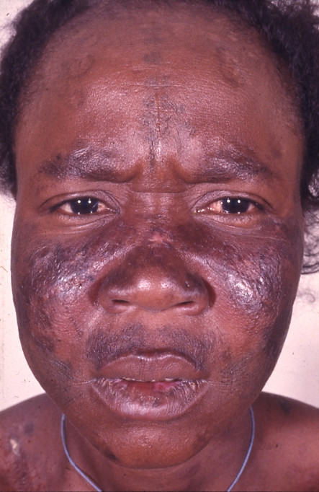

Slide 21
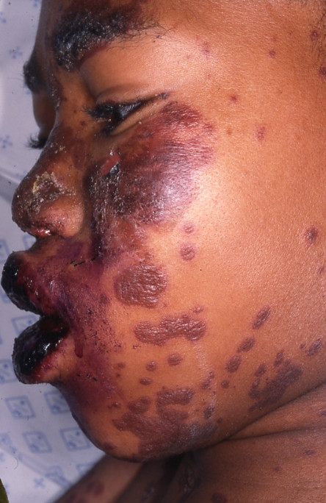

Slide 22
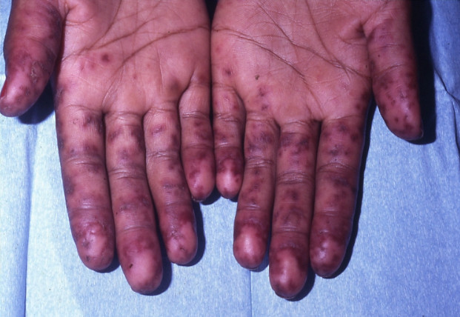

Slide 23
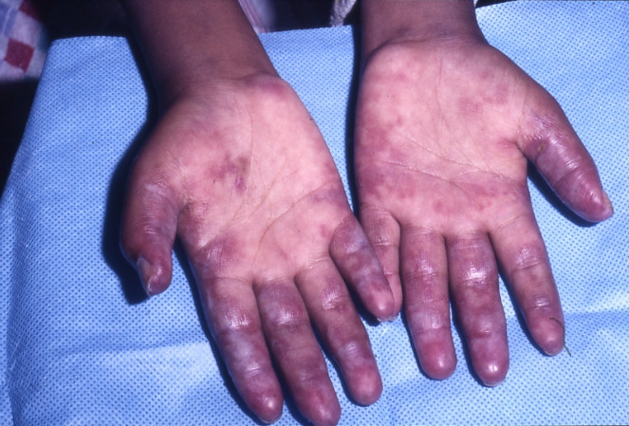

Slide 24
Treatment
Symptomatic depending on which system or systems are involved
Management of anaemia, cardiac failure, kidney disease, joint involvement, seizures……..
Sytemic corticosteroids
Immunosuppressors- cyclophosphamide, azathioprine, chlorambucil
Biologicals
Use the medications promptly, adjust the dose on clinical rather than laboratory findings

Slide 25
Subacute Cutaneous LE
In between dLE and SLE
However, different HLA associations, less severe systemic involvement
Skin lesions superficial non-scarring, annular or psoriasiform
Severely photosensitive

Slide 26
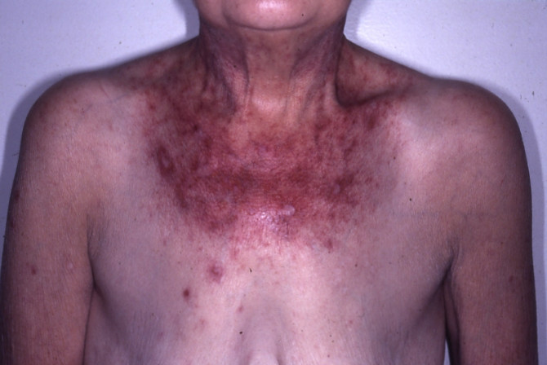

Slide 27
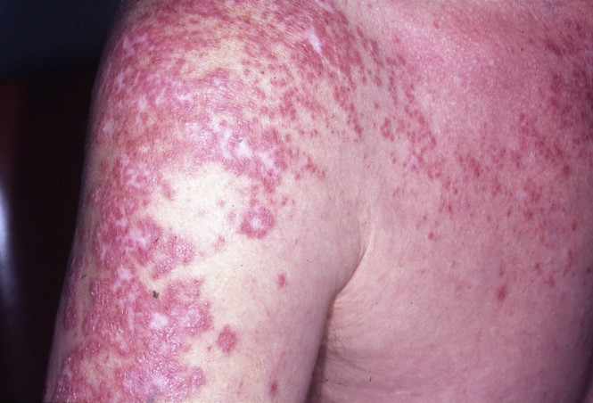

Slide 28
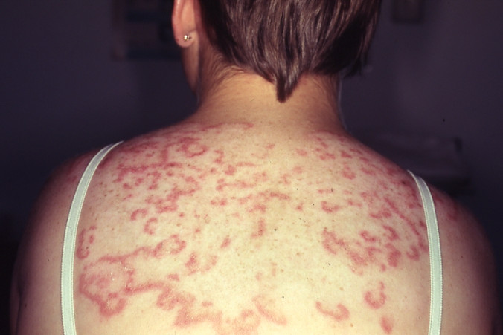

Slide 29
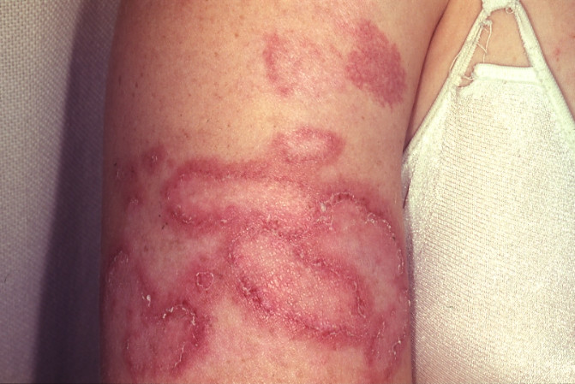

Slide 30
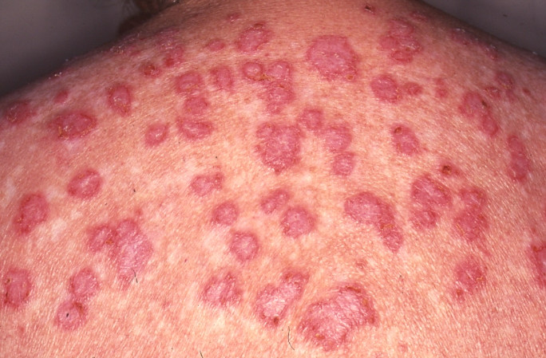

Slide 31
Treatment
Chloroquine
Systemic corticosteroids
Dapsone
Thalidomide

Slide 32
Scleroderma
Localised – morphoea
Systemic – progressive systemic sclerosis

Slide 33
Morphoea
Thickened area often surrounded by a lilac ring
Plaques, bands, linear
Females more often than males
Not rare in children
Aetiology?
Trauma, genetics, association with autoimmune disease

Slide 34
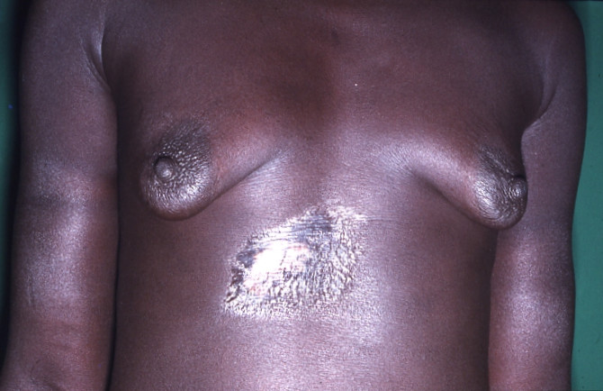

Slide 35
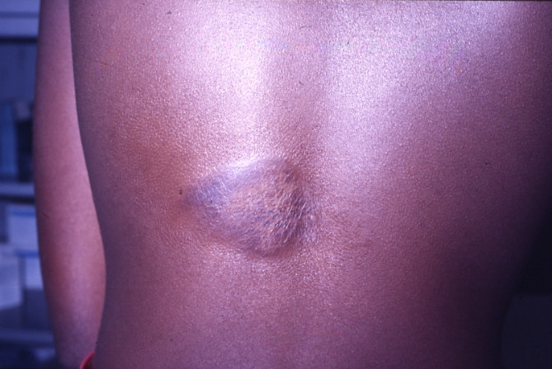

Slide 36
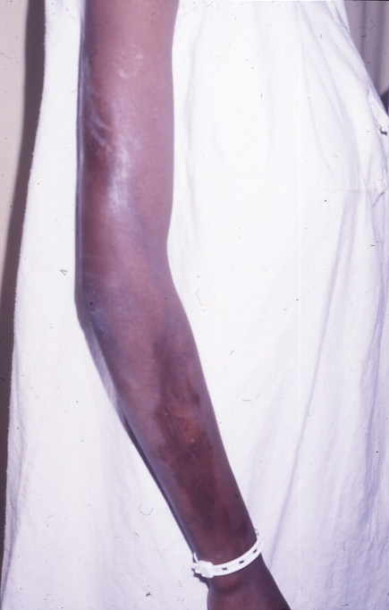

Slide 37
Histology : thickening of collagen, inflammation in early stages at lower dermis
Natural history towards spontaneous resolution

Slide 38
Treatment
Difficult
Intra-lesional Corticosteroids
Vit- D preparations
D-penicillamine?

Slide 39
Progressive systemic sclerosis(scleroderma)
Onset – adult life
F:M -4:1
Often starts Raynaud’s phenomenon(paroxysmal pallor of the digits provoked by cold)
Cutaneous changes
Most often hands, feet and face-acroscleroderma but may appear anywhere- trunk, proximal segments of the limbs- diffuse scleroderma – usually more severe course

Slide 40
Cutaneous changes
Hands – 1st swollen later atrophic, sclerodactyly, painful ulcers on the fingers, atrophy of the terminal phalanges
Face – beaked nose and radial furrowing around the mouth
Trunk – abnormalities of pigmentation ‘mottling’-hyper and hypo pigmentations
Areas of hard indurated skin

Slide 41
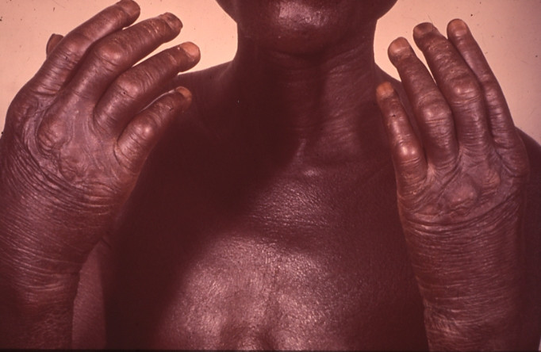

Slide 42
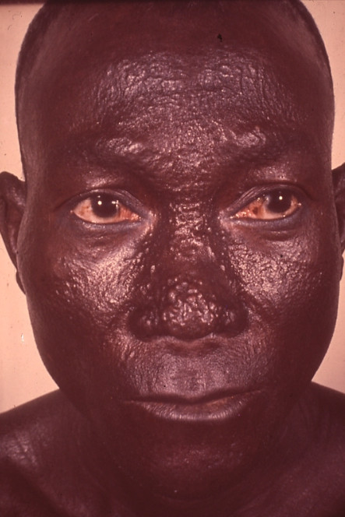

Slide 43
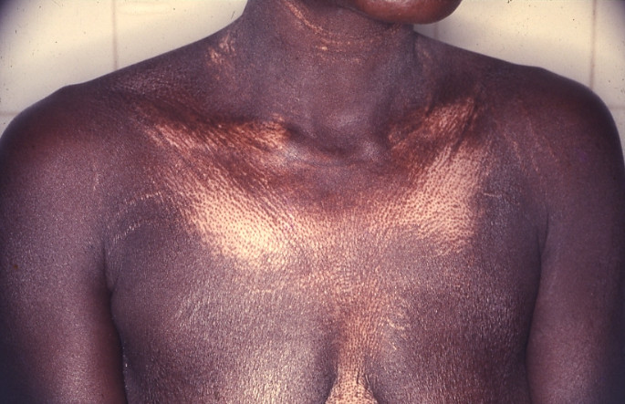

Slide 44
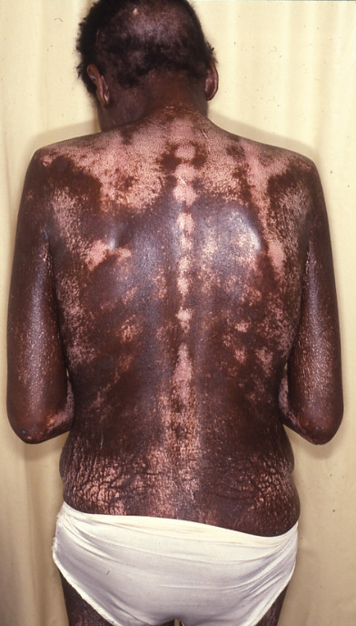

Slide 45
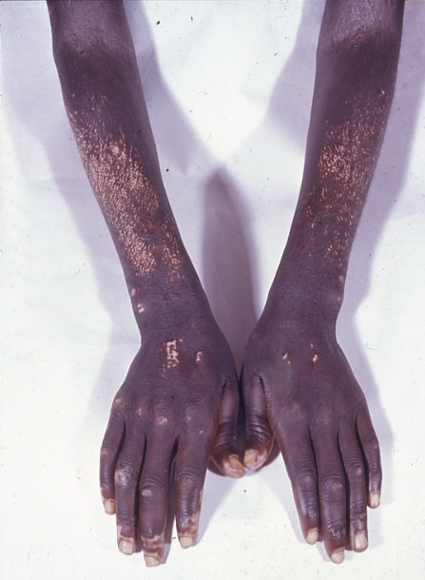

Slide 46
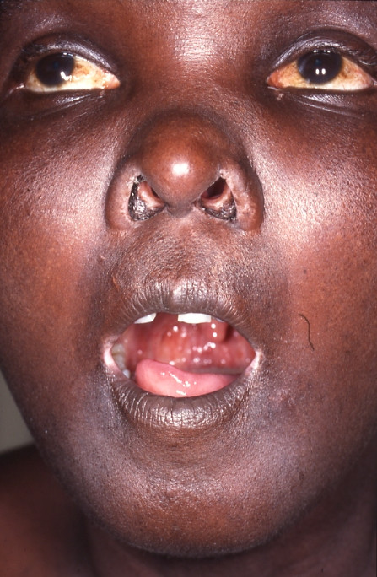

Slide 47
Aetiology
Vascular injury
Collagen changes
Altered immune regulations
Which is primary?

Slide 48
Involvement of internal organs
GIT-oesophagus 75%, dysphagia, oesophageal reflux
Colon- diverticulae, constipation or diarrhoea
Jejunum and ileum- malabsorption
Lungs – progressive diffuse alveolar fibrosis
Heart
Kidneys –frequent
Laboratory :
ANA+, Antinucleolar, Anticentromere
SCl-70

Slide 49
Prognosis
Depends on systemic involvement
Usually a progressive course

Slide 50
Treatment
There is no therapy known to alter the course of the disease
Symptomatic treatment of internal problems
Systemic corticosteroids?
Immunosuppressors?
D-penicillamine?

Slide 51
Dermatomyositis
Inflammatory myopathy and characteristic cutaneous disease
Cutaneous lesions may precede evidence of muscular involvement by several months
Is so-called amyopathic dermatomyositis a form or a phase?

Slide 52
Diagnostic criteria
Proximal symmetrical muscle weakness
Increased serum levels of muscle enzymes(CK, SGOT, aldolase) or another evidence of muscle breakdown (increased urinary creatinine excretion)
EMG consistent with dermatomyositis
Muscle biopsy consistent with dermatomyositis
Skin findings typical or compatible with dermatomyositis

Slide 53
Skin changes
“Heliotrope” facial rash- periocular
Swelling of the face- African patients
Pigmentary changes – hypo and hyper pigmentations
So called Gottron’s papules over the knuckles

Slide 54
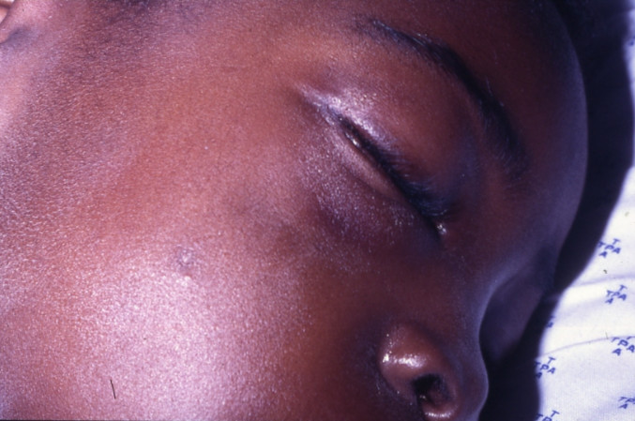

Slide 55
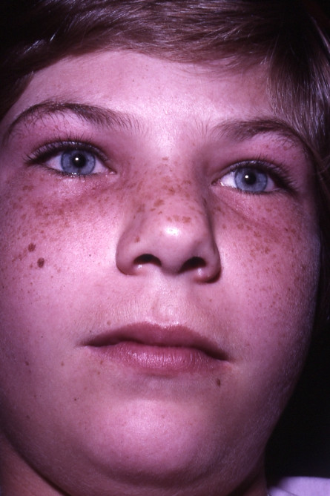

Slide 56
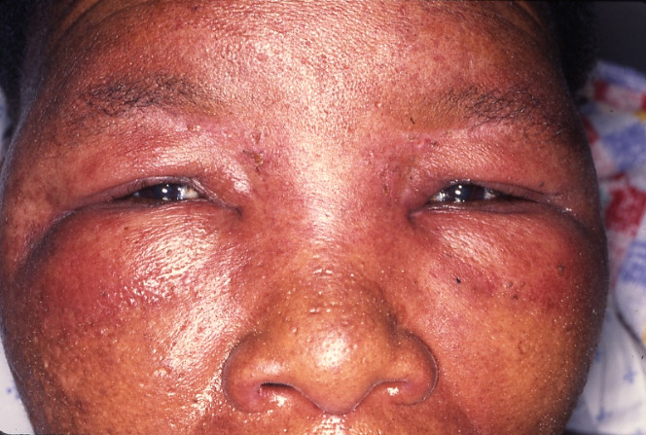

Slide 57
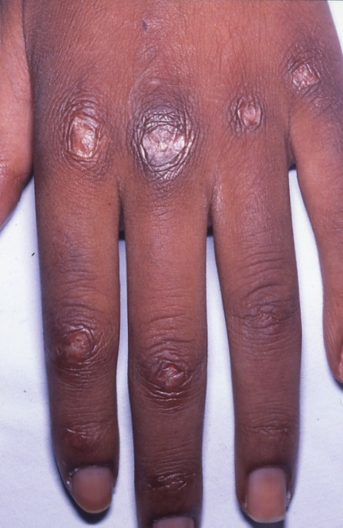

Slide 58
Systemic involvement
Pulmonary – not rare, often severe, diffuse interstitial fibrosis, may be fatal
Cardiac
Joints
Calcinosis- more often in childhood dermatomyositis
Dermatomyositis can be a marker of internal malignancy in adults

Slide 59
Treatment
Systemic corticosteroid- the mainstay of therapy
Full therapeutic dose 60-120 mg per day in adults
1.2-1.5 mg/kg/day in children
Low dose results in worse prognosis than no therapy
Immunosuppressors
Intravenous IgG
Chloroquine for skin lesions
General measures –nutrition and physiotherapy

