Slide 1
Eating Disorders:
Dr M Joubert
Specialist Psychiatrist
SBAH

Slide 2
What is the core of Eating disorders?

Slide 3
Core of Eating Disorders:
Morbid Fear of weight gain/misconception body weight/shape
Disordered Eating behavior

Slide 4
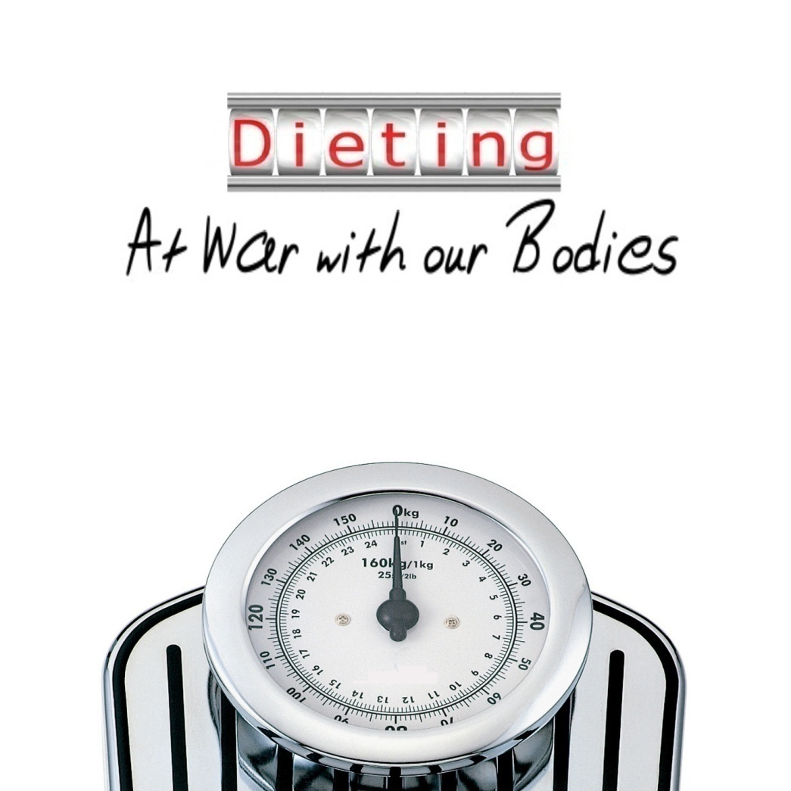
Etiology/risk Factors
Etiology multi-factorial with biological, psychological and environmental factors
At this stage more appropriate to talk about risk factors:

Slide 5
Risk Factors:
dieting
e.g. BN can start with a episode of dieting
8 x increased risk to develop eating disorder
Media:
have a negative effect on those already at risk
Family:
More emphasis on family’s role in recovery/outcome rather than causing ED
Stressful life events:
AN episode can start stressor,
increased incidence sexual abuse in BN

Slide 6
Psychological factors:
low- self esteem,
perfectionism,
impulsiveness
Culture:
more western culture
Gender:
female more than male
Socio-economic:
AN no bias.
BN lower
SES
Biological: definite genetic basis
Other psychiatric co-morbidity:
mood,
Substance abuse etc.

Slide 7
DSM IV TR
DSM IV-TR defines 3 Eating Disorders
Anorexia Nervosa (AN)
Bulimia Nervosa (BN)
Eating Disorder NOS (EDNOS)
Suggested additional diagnoses
Binge Eating Disorder
Obesity

Slide 8
Anorexia Nervosa: ( DSM)
. Refusal to maintain body weight at or above a minimally normal weight for age and height (less than 85% of that expected or failure to make expected weight gain during period of growth)
B. Intense fear of gaining weight or becoming fat even though underweight
C. Disturbance in experience (perception) of own body weight or shape, with undue influence on self -evaluation or denial of seriousness of current low body weight

Slide 9
Anorexia Nervosa: DSM 1V Criteria continue
In post-monarchial females, amenorrhea: absence of at least 3 consecutive menstrual cycles
Subtypes:
Restricting type: during current episode of AN, has not regularly engaged in binge-eating or purging ( for example: self-induced vomiting, misuse laxatives, diuretics, enemas)
Binge-eating-Purging type: during current episode, the person has regularly engage in binge-eating or purging behavior (self-induced vomiting, misuse laxatives, diuretics, enemas)

Slide 10
Thus Summary AN
Remember the Core Symptoms of Eating Disorders:
Fear Of gaining Weight
Disturbance in how body weight experience
Signs of malnutrition:
Amenorrhea Abnormal eating :
Refusal to maintain minimum of Normal body weight for age:
DSM 85%
ICD 10: BMI 17.5
Binging/
purging/
restricting

Slide 11
DSM Criteria BN:

Slide 12
DSM Criteria BN:
A. Recurrent episodes of binge eating, characterized by:
1. Eat within 2-hour period (discrete period of time), an amount of food larger than most people would eat during similar period
2. Sense of lack of control over eating during episode (feel that one cannot stop eating or control how much is eating)
B. Recurrent inappropriate compensatory behavior to prevent weight gain (self-induced vomiting, misuse of laxatives, diuretics, enemas, fasting, excessive exercise
Does not have to be vomiting

Slide 13
BN DSM criteria ( continue)
. Binge eating/compensatory behaviors occur at least twice a week for 3 months
D. Self-evaluation unduly influenced by own body perception
E. Disturbance does not occur exclusively during episodes of anorexia
Subtypes:
Purging; during current episode of BN patient regularly engaged in self-induced vomiting, misuse of laxatives, diuretics, enemas
Non-purging during current episode of BN patient has regularly used other inappropriate compensatory behaviors ,such as fasting or excessive exercise, but has not engaged in self-induced vomiting, misuse of laxatives, diuretics, enemas
Weight not less than 85%of expected

Slide 14
BN summary of criteria:
Compensatory influenced by body
Behavior Perception
( which include e.g. abn eating
Exercise etc)
Binging

Slide 15
Note on Younger populations:
Current DSM formulations are not sensitive to younger persons with eating disorders
Weight criterion for AN (i.e., 85% ideal body weight or BMI of 17.5 kg/m² ) is problematic for a population where growth is still expected
This workgroup suggested that failure to grow as a result of malnutrition -an event particular to childhood- should serve as a substitute for meeting the usual criteria of AN
Menstrual criteria are difficult to apply to youth who are pre-menarcheal; or has established menstruation; also no equivalence for amenorrhea in boys with AN
Majority of adolescents with disturbed eating behaviour: categorized as EDNOS

Slide 16
Distinguishing AN/BN
1)Both fear of gaining weight/misconception of body image
2)both can have binging, purging, restriction, exercise etc
Anorexia
1)Weight must be below 85% of expected
2)Can have any abnormal eating behavior including binging and purging
Bulimia:
1)Weight must be above 85% of expected
2)Must have binging with compensatory behavior which can be restriction/exercise( does not have to be purging)

Slide 17
Associated Features AN:

Slide 18
Associated Features AN:
Depressive SX:
social withdrawal, irritability,
insomnia
anhedonia
OCD type symptoms
Preoccupied thought of food
Hoard food/ recipes
Odd behavior at mealtimes
Concerns eating in public
Poor sexual adjustment
Personality:
feelings ineffectiveness.
need control,
perfectionism,
Inflexible thinking
Often caused/
exacerbated by under nutrition
Social phobia
More restrictive type

Slide 19
Associated Features BN/Binge and purging subtype AN
Depressive Sx
But also mood lability
Anxiety( social situations)
Substance abuse
Personality ( borderline)
More impulse control problems

Slide 20
Co-Morbidity:
Anorexia
MDD( 65%)
Social phobia (35%)
OCD ( 25%)
Personality disorders
OCPD vs. borderline
Somatoform ( often physical complaints)
Bulimia
MDD but also Bipolar
Anxiety
Impulse control disorders
Dissociative disorders
Substance use disorders
Personality ( borderline)

Slide 21
Differential Diagnosis AN
Other eating disorders
Medical illness
TB
brain tumor
HIV
Malignancies
Diabetes
Thyrotoxicosis
Depressive disorders
Avoidant PD
Somatization disorder
Schizophrenia or a psychotic disorder
Body dysmorphic disorder
Weight loss but no desire to lose weight/distorted body image
Can have odd eating behavior

Slide 22
Differential Diagnosis BN:
Other eating disorders
MDD with atypical features( Increased appetite)
Medical illness e.g. Klein- Levin syndrome with disordered eating, brain tumors, epilepsy
Borderline personality disorder
Binging and purging part of definition of Borderline PD
Diagnose both if criteria present

Slide 23
Physical Examination: Starvation
Must treat medical abnormalities/watch out for pharmacotherapy S/E
Cardiac: small heart, loss of cardiac muscle, prolonged QT, arrhythmia, bradycardia
Neuropsychiatric: abnormal taste, apathetic depression, mild cognitive disorder
Gastro-intestinal: delayed gastric emptying, bloating, constipation
Cachexia: loss of fat, muscle mass
Dermatologic: lanuga (fine baby hair), edema
Skeletal: osteoporosis
Reproductive: amenorrhea which reflects lower hormonal levels, low LH, low FSH
Hematological: leukopenia
Vitamin and mineral deficiency
Hypercholesterolemia Early starvation

Slide 24
Physical examination: Binging and Purging
Metabolic:
electrolyte abnormalities:
hypokalemic,
hypochloremic
alkalosis, acidosis
hypomagnesemia
Hypercholesterolemia, elevated cortisol, anemia
Digestive-gastrointestinal: salivary gland inflammation with increased serum amylase, esophageal and gastric erosion
Dental: erosion of dental enamel, front teeth
Neuropsychiatric: seizures due to large fluid shifts, mild neuropathies, fatigue, weakness
Thyroid function is suppressed as well
Several CT (computed tomographic) reveal enlarged CSF spaces (enlarged sulci & ventricles)

Slide 25
Suggested Special Investigations:
FBC
UCE NB Daily when busy re-feeding
CMP
Glucose
LFT +/- clotting screen
ECG
VIT B12 Folate
TFT
Bone density screen
Patients eating disorders higher rates of type 1 diabetes!!!

Slide 26
Course and prognosis:
50% AN binging/purging type progress to BN
AN
Lifetime prevalence: 0.5%
The older the patient at onset, the worse the prognosis
8 – 15% mortality rate
25% full recovery after 10 years
BN
Lifetime prevalence: 1-3%
Chronic, waxing and waning course
50% full recovery after 5 – 10 years
20% full criteria still met after 5 – 10 years

Slide 27
Treatment AN:

Slide 28
Treatment AN:
Very much team approach
Medical
Complimentary: dietician
Psychiatric
psychology
Family
Severe under-nutrition medical emergency thus
must admit if necessary under mental health care act
In other cases try Motivate for change
educate

Slide 29
Treatment AN:
Must be your first goal!
Little therapy attempted due to impaired mental state secondary to severe malnutrition
Usually prescriptive behavioral techniques
Aims of treatment
1)Weight restoration
2)Weight maintenance
Treating core of AN
Treating co-morbidities
Psychosocial difficulties
Usually family therapy
Increasing evidence CBT
pharmacotherapy

Slide 30
Weight restoration/re-feeding
First step: Inpatient/outpatient?
Criteria for inpatient treatment:
Very low weight( APA says if below 85%, A BMI less than 13 is associated with significant increase in mortality( should admit before then), rapid weight loss of more than 1kg/week increases risk
Poor cardiac status( APA: HR below40,BP below 90/60,arrythmias,
electrolyte imbalance,
hypoglycemia,
hypothermia
Refusal to eat
Neuropsychiatric symptoms necessitates admission e.g. psychosis, suicide etc
Be careful not to overload with fluids

Slide 31
NB points to note re-feeding stage: Food =lifesaving medicine
Severe malnutrition=medical emergency

Slide 32
NB points to note re-feeding stage:
Very little individual insight orientated therapy attempted:
impaired mental state due to malnutrition
Very much behavioral approach
Force feed if necessary via NG tube: if complete refusal to eat.
NB stabilize medical complications
Neuropsychiatric sx
(depression, anxiety, OCD etc)
usually complication of under nutrition:
no need for pharmacotherapy
( usually does not work)
Most likely improve with weight restoration
Can be dangerous e.g. QT prolongation of AP

Slide 33
AS with all treatment: re-feeding also has complication( side effects)
Re-feeding syndrome
Metabolic disturbance as result of reinstitution of nutrition,( usually after 4 days)
fluid and electrolyte disturbance(Hypophosphataemia),
cellular dysfunction,
cardiac failure,
arrhythmias,
seizures,
coma death
Try prevent:
reinstate nutrition slowly( below daily required)
At least daily electrolyte monitoring
Correct( orally safest)
Most at risk:
Little nutrition 5 days
Lower the weight
More rapid weight loss( more than 15% in 3 months)
Already abnormal electrolytes pre re-feeding

Slide 34
AN: Weight maintenance
Goals:
Address core sx AN
Cognitive disorders
Body image distortion
Fear of weight gain
Abnormal eating and associated behavior
Address co-morbid psychiatric disorders
Can use judicial pharmacotherapy depending on intensity of symptoms
Look out for dangerous side effects e.g. lowering seizure threshold
Re-establish social engagement

Slide 35
AN: Weight maintenance
Therapy
Most evidence family therapy
Increasing evidence CBT
pharms
No pharmacotherapy
Tx core symptoms
Some evidence olanzapine:
reports increase weight, decrease fear of weight gain, also reduce resistance to treatment, also decrease depression, anxiety, OCD
Treatment modalities:

Slide 36
Treatment BN

Slide 37
Treatment Bulimia Nervosa:
Admission rarely needed
First line treatment: CBT
+/-
same goals as for AN
Pharmacotherapy:
fluoxetine 60mg evidence decrease binging and purging( FDA registered)
Topiramate also evidence reduce binging and purging

Slide 38
Case Study:

Slide 39
Case Study:
17 year old Caucasian girl without a prior psychiatric history; brought into ER Tshwane after being found at home having a seizure
Admitted to medical intensive care unit in status epilepticus
Quickly stabilized with intramuscular lorazepam and fosphenytoin loading.
Medium build; height 5 feet 6 inches, weight 100pounds (BMI 16.3kg/m²

Slide 40
Case Study:
First seizure, no medical conditions
Laboratory workup shows electrolyte imbalance as most likely cause of seizures
Although initially reluctant she admits purging with the use of ipecac several times this week
She normally restricts her daily caloric intake to 500 calories
Regularly induces vomiting if weight is above 100

Slide 41
Case Study:
Last normal menstruation cycle was 1year ago
Reason for consultation is to confirm her diagnosis
You find that she appears underweight and younger for her age; she is in mild distress, exhibits poor eye contact, reports feeling ‘sad’
She admitted to experiencing constant preoccupation about her physical appearance
“I am fat; I hate my body”

Slide 42
Case Study:
She also reported insomnia, low energy levels, history of self-harm behaviour (cutting forearms); try to hide symptoms from parents who are very strict
Her mother described her as a perfectionist; involved in multiple school activities ; high achiever and they expect her to become a doctor!
Parents attributed underweight (rarely see her eat) to stress from her academic pursuits
Cathy’s mom receives treatment for obsessive –compulsive disorder

Slide 43
Case Study:
What is Diagnosis?
Why?
Any co-morbidity?
Treatment
In/outpatient?
Why?
Any psychopharmacology indicated?

Slide 44
Questions?:

