Slide 1
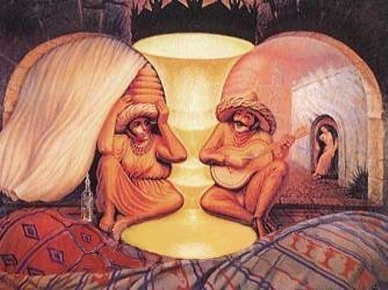
Infections in the elderly
Anton Stoltz
Mmed (Int), PhD
Subspecialist adult Infectious Diseases

Slide 2
Lecture on Infection in the elderly
If you had to choose – guy thing
Drivers of Infection
Concept of an aging world
Effect of old age on the immune system
Rational use of antibiotics
UTI in the elder patient
Pneumonia in the elder patient
Pressure sores and soft tissue infections
Tuberculosis in the elder patient
Bacteraemia and Infective endocarditis

Slide 3

Drivers of Infection

Slide 4
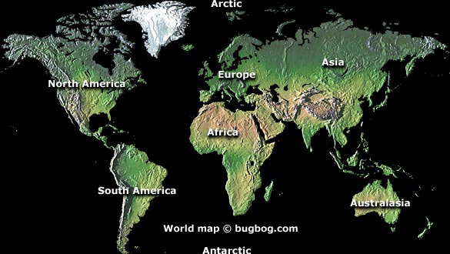
Emerging and re-emerging Diseases
Cholera
Syphilis
Small pox
Spanish Influenza
Yellow fever
Measles
(430 BC up to 1981)
David M Morens, Gregory K Folkers, Anthony S Fauci, Emerging infections: a perpetual challenge

Slide 5
Emerging and re-emerging Diseases
MDR TB
Nipah virus
SARS
Hep C
Lymes disease
Chikungunya
West Nile
H5N1 Influenza
Malaria
Polio
Ebola
H1N1 Influenza
Yellow fever
Plague
Lassa
Cholera
HIV
E. coli 0157:H7
XDR TB
Rift Valley Fever
Hep B
H5N2 Influenza
(1977–2007)
David M Morens, Gregory K Folkers, Anthony S Fauci, Emerging infections: a perpetual challenge

Slide 6
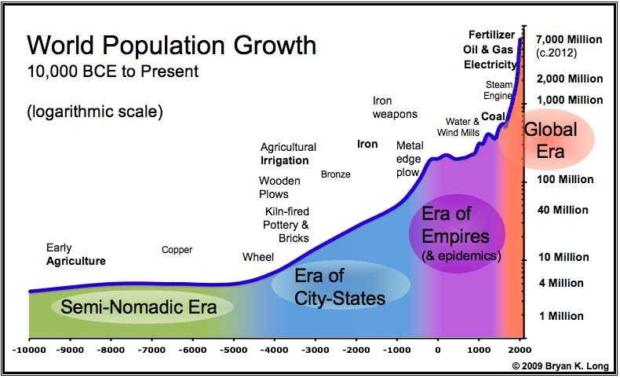
It took all of history up until 1830 to put 1 billion people on the planet
By 1930, 100 years later, there were 2 billion people on the planet
By 1974, 44 years later, there were 3 billion people on the plane
By 1986, 12 years later, there were 4 billion people on the planet
The world population now stands at 7 billion
“It now takes only 4 days to replace one million people.”

Slide 7
Increase in Global temperature

Slide 8
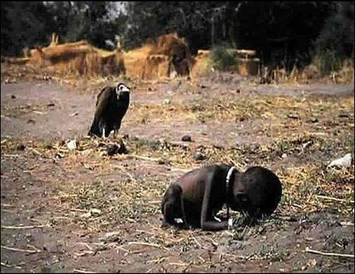
Poverty
Famine
War
Emerging and reemerging diseases
Kevin Carter
Photo by: Kevin Carter

Slide 9
Drivers of Infectious diseases/HIV
Driver – legislation and systems of government
Disease sources
Driver – technology and innovation
Disease outcomes
Driver – conflict and war
Disease pathways
Driver – economic factors
Driver – human activity and social pressures
Foresight. Infectious Diseases: preparing for the future. OFFICE OF SCIENCE AND INNOVATION. UK

Slide 10
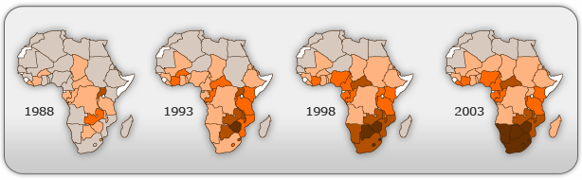
Driver – legislation and systems of government
20%-30%
10%-20%
5%-10%
1%-5%
0%-1%
no data

Slide 11

Driver – Conflict and war
Number
160 rapes per day
3200 rapes per day

Slide 12
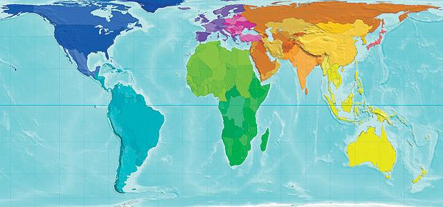
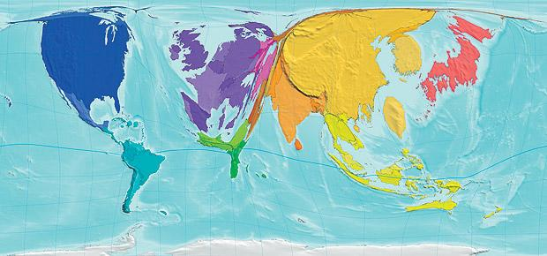
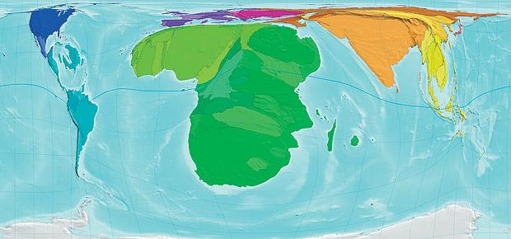
Driver – Economic factors

Slide 13

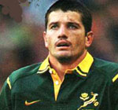
Driver- Human activity and social pressures
Hero
Leader
Idol

Slide 14

The aging world

Slide 15
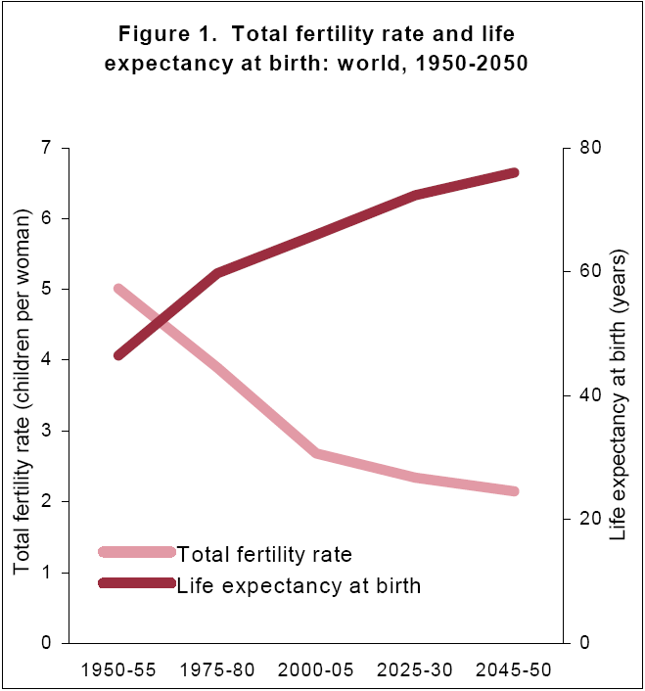
Fertility rate and life expectancy at birth

Slide 16
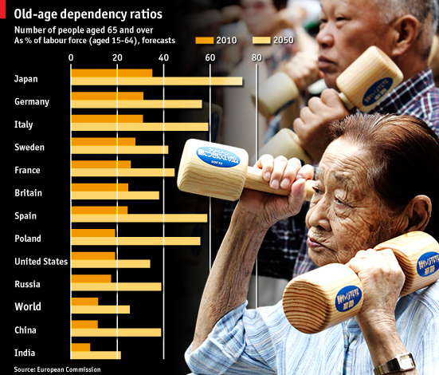

Slide 17
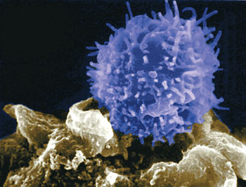
Immunity in the elderly

Slide 18
Immune system
Innate immunity
(Non specific immunity)
Natural barriers
Adaptive immunity
(Specific immunity)
Cellular immunity:
T cells
Humeral immunity: B cells
Soluble elements:
Complement
Acute phase proteins
Cytokines
Cellular elements:
Monocytes
Neutrophils
Macrophage
Dendritic
Natural killer
Antibodies
CD4⁺
T helper cells
CD8⁺
Cytotoxic cells
Natural killer cells

Slide 19
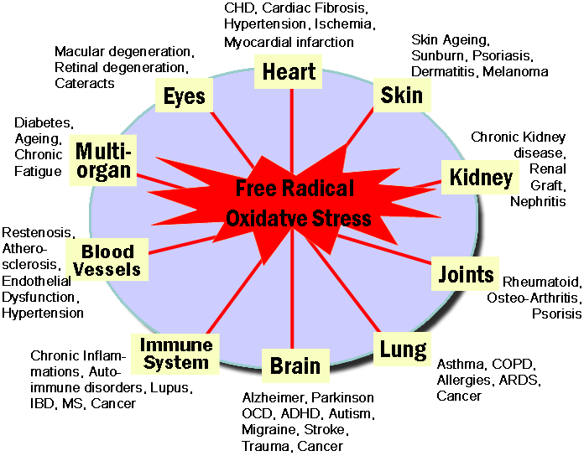

Slide 20
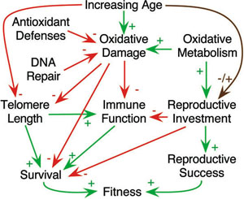
Telomere length and age of the cell

Slide 21
Systemic immune activation
in old age
Sustained T cell
apoptosis
Secretion of
Pro-inflammatory
cytokines
Inflammation related disorders
Osteoporosis
Atherosclerosis
Neurocognative deterioration
Frailty
Inflammatory – aging
Exhaustion of
Immune resources
Decline of regenerative capacity
Loss of effective HIV immunity
Immunosenescence

Slide 22
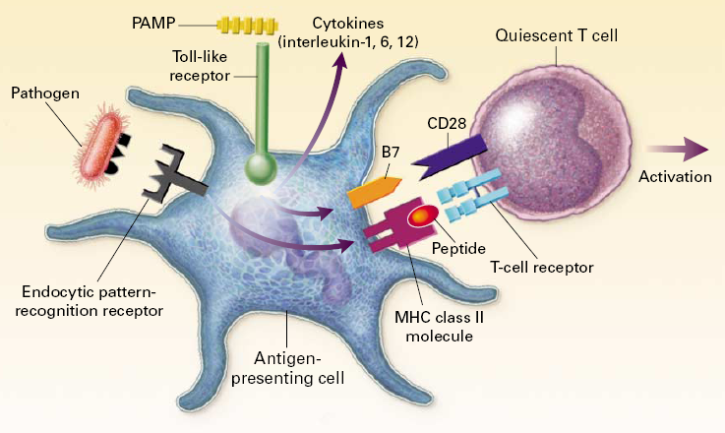
Innate and adaptive immunity

Slide 23
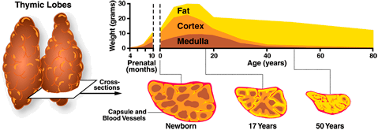
Involution of the thymus with age

Slide 24
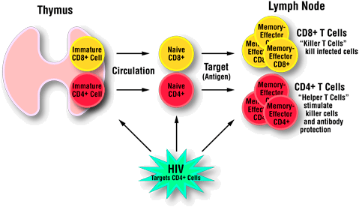
Role of thymus in Infections
Old age

Slide 25
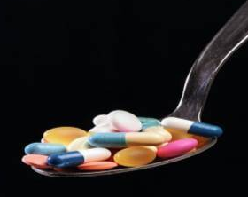
Rational use of antibiotics

Slide 26
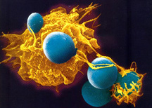
War of the microbes
18 000 000 people develops sepsis every year
4 000 000 patients die every year of septic shock

Slide 27

Change in paradigm for antibiotic use
OLD | NEW
Start with penicillin | Get it right the first time
Cost –effective low dose | Hit hard up front
Low dose = less side effects | Low dose = resistance (Pk/PD)
Long courses > 2 weeks | Seldom longer than 7 days
Hit Hard and go home
Crit care and resus citation, Vol 11 number 4 December 2009

Slide 28
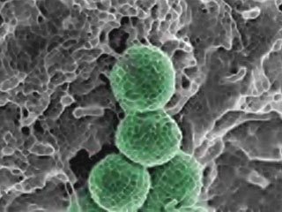
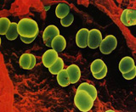
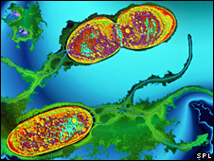
Organisms naturally resistant
to Meropenem
Methicillin-resistant Staphylococcus aureus (MRSA)
Enterococcus faecium
Stenotrophomonas maltophilia.
Drugs, 2008, 68(6) 803

Slide 29
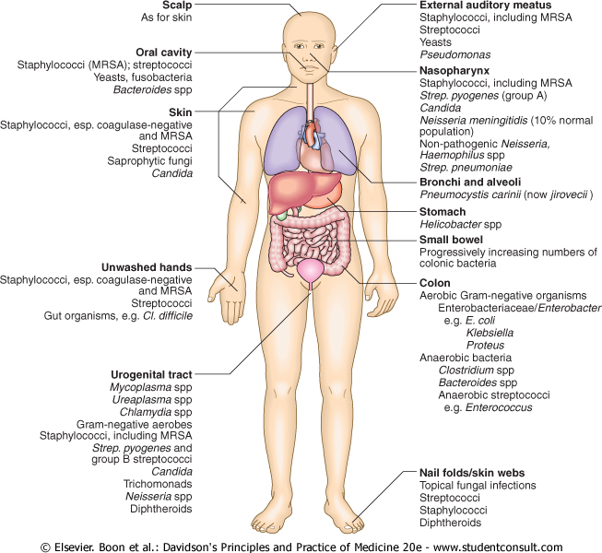
Colonisation

Slide 30
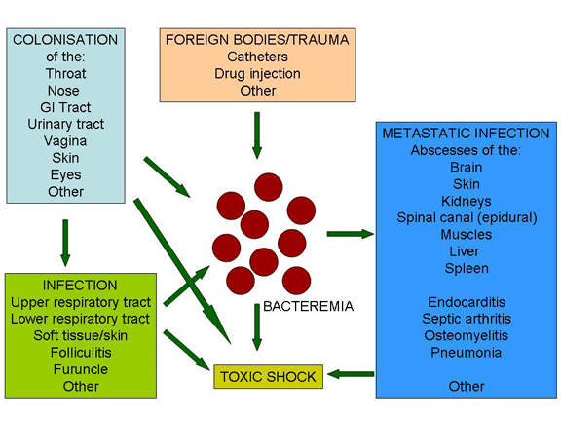
Colonisation to Infection
pathmicro.med.sc.edu/infectious%20disease/inf

Slide 31
Mortality associated with initial inadequate therapy in patients with serious infections
Rello et al
Infection-related mortality
Initial adequate therapy
Initial inadequate therapy
Kollef et al
Crude mortality
Ibrahim et al
Infection-related mortality
Luna et al
Crude mortality
0
20
40
60
80
100
Mortality (%)
Rello et al. Am J Respir Crit Care Med 1997;156:196–200.
Kollef et al. Chest 1998;113:412–420. Ibrahim et al. Chest 2000;118:146–155;
Luna et al. Chest 1997;111:676–685

Slide 32
Clinical Pharmacology
Vd
Cl
T_{1/2}
Antibiotic
C_{Max}
C_{min}
Pharmacokinetics
AUC
Host
T> MIC
Pharmacodynamics
Cmax/MIC
AUC/MIC
Bacterium

Slide 33
Pharmaco-kinetics – Gender
Differences between the genders exert the greatest
influence on pharmacokinetic parameters
• Ratio of body fat to lean muscle mass
Difference in glomerular filtration rate

Slide 34
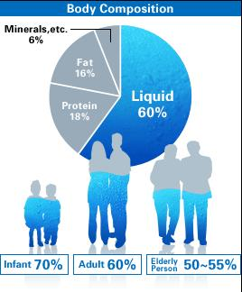
Body water and Fat
total water: | 60% (50-80%) | 42 L
intracellular volume: | 40% | 28L
extracellular volume: | 20% | 14L
plasma volume: | 4% | 3L
blood volume: | 8% | 5.5L

Slide 35
Pharmakinetic considerations
Aminoglycosides
β-lactams
Glycopeptides
Colistin
Fluoroquinolones
Macrolides
Tigecycline
Lincosamides
Antibiotic
Hydrophilic
Lipophilic
Extracellular water
Body fat
Intracellular
Bioaccumulation

Slide 36
Pathophysiological changes and
effects on pharmacokinetics
VAP/Sepsis
+
Noradrenaline
Increased
Cardiac Index
Leaky capillaries &/or
altered protein binding
Increased
Clearance
Increased Volume
of Distribution
Augmented Renal Clearance
(ARC) up to 250 mL/min
Low Serum Drug Concentration
Barbot A, Intensive Care Med;29:552
Crit Care and Resuscitation;11 (4): 276

Slide 37
Protein binding and
antibiotic concentration
Albumin
(Acidic antibiotics)
Alpha 1 acid glycoprotein
(Basic antibiotics)
β lactam antibiotics
Fluroquinolones
Clindamycin
Free drug: microbiologically active
Highly bound drug: Low Vd and increased duration

Slide 38
Effect of Protein binding on pharmacokinetics
ceftriaxone (85-95% protein binding)
Teicoplanin
Aztreonam
Fusidic acid
Daptomycin
Ertapenem
Relative level

Slide 39
Elimination
The elimination of a drug is referred to as its clearance
Creatinine clearance is used as a measure of the glomerular filtration rate
Drug clearance is reported as units of plasma (or blood) cleared per unit time
Rate of elimination (Ro) = clearance (CI) x plasma concentration (Cp)

Slide 40
Kill characteristics of Different
Antibiotic Classes
Concentration
dependant
Aminoglycosides
Daptomycin
Telithromycin
C_{max}/MIC
Drug Plasma Concentration
MIC₉₀
Time
C_{min} = Trough
.
Craig WA. Clin Infect Dis. 1998;26:1-12.

Slide 41
Kill characteristics of Different
Antibiotic Classes
Vancomycin
Teicoplanin
Tigecycline
Linezolid
Ciprofloxacin
Azithromycin
AUC₀₋₂₄
MIC₉₀
Drug Plasma Concentration
AUIC
MIC₉₀
Time
C_{min} = Trough
.
Craig WA. Clin Infect Dis. 1998;26:1-12.

Slide 42
Kill characteristics of Different
Antibiotic Classes
β lactam antibiotics
Carbapenems
Clindamycin
Drug Plasma Concentration
Time
dependent
T> MIC
MIC₉₀
Time
C_{min} = Trough
.
Craig WA. Clin Infect Dis. 1998;26:1-12.

Slide 43
Kill characteristics of Different
Antibiotic Classes
(β Lactam antibiotics)
4-5x MIC
Drug Plasma Concentration
MIC₉₀
0
12
24
Time (h)

Slide 44
Pharmacokinetic principles
25
IR 2000 mg
20
Immediate-release amox/clav (2000 mg amoxycillin)
SR 2000 mg
Augmentin® SR extended-release amox/clav (2000 mg amoxycillin)
Immediate-release amox/clav
(875 mg amoxycillin)
Mean amoxycillin concentration
(µg/mL)
IR 875 mg
10
2 µg/mL
0
0
2
4
6
8
10
12
Time (hours)
Adapted from Kaye CM, et al. Clin Ther. 2001;23:578-584.
Notes:
44
Kaye et al combined 500 mg Augmentin plus 1500 mg amoxicillin for Augmentin IR 2000 mg. Shows high peak, but not extended release like Augmentin XR.
Augmentin XR extends exposure of the pathogens to amoxicillin, thereby extending the killing time of the antibiotic.

Slide 45
Effect of duration of Antibiotics
on recurrence of disease
Difference 2.9%, 90% CI, - 3.2 to +9.1
28.9%
26%
Pulmonary infection recurrence %
Chastre J., JAMA, 2003, 290, 2588

Slide 46
Antibiotic duration and probability of
drug resistant organisms
62.3%
P=0.038
Probability of emergence
of MDR pathogens
42.1%

Slide 47
The extreme of ages
The extremes of age are appreciated as periods of increased susceptibility to infection
Elderly ( 65 years of age or older)
  Impairment of cell-mediated and humoral immunity
  Reduced physiologic functions such as cough reflex
  Circulation
  Wound healing

Slide 48
Infections in the elderly
More frequent infections
  Herpes zoster
  Listeriosis
  Urinary tract infection
  Bacteremia
  Meningitis
Less common infections
  Sexually transmitted diseases

Slide 49
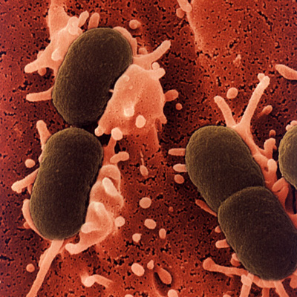
Urinary tract infections

Slide 50
Urinary tract infections
Urinary tract infections (UTIs) are more common in women than men - until advanced age

Slide 51
Urinary tract infections
In men, bacteriuria becomes increasingly prevalent with age,
  largely as a result of urethral obstruction caused by prostatic hypertrophy
The prevalence of bacteriuria in the elderly is approximately 10% in men and 20% in women

Slide 52
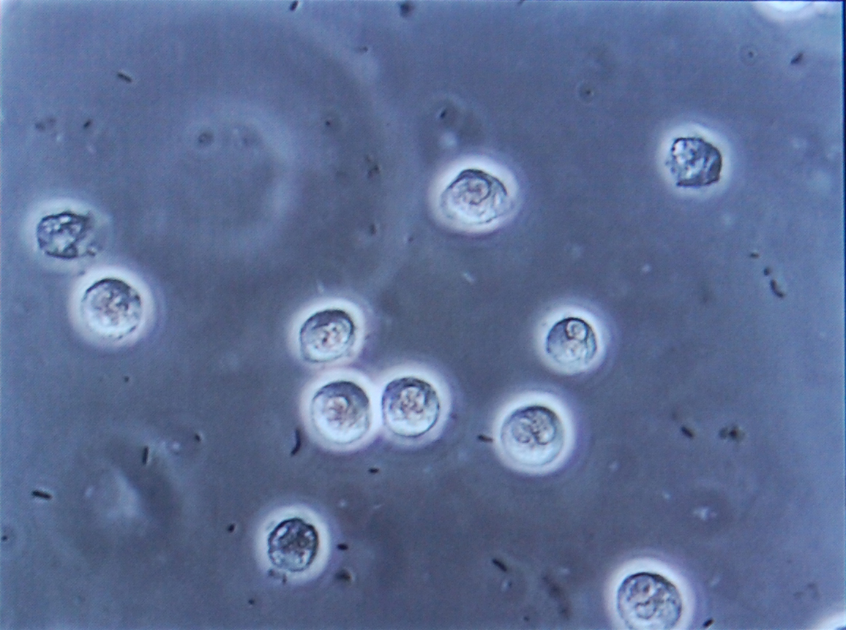
Bacteriuria

Slide 53
Urinary tract infections
Asymptomatic bacteriuria in the elderly does not require antibiotic therapy
Functionally disabled elderly individuals are more prone to have bacteriuria

Slide 54
Who to treat?
Symptomatic UTI should always be treated in older individuals
Antibiotic selection should be guided by a Gram-stained specimen of urine and the patient's history
  Residence in a nursing home
  Recent hospital stays
  Previous antibiotic therapy
  History of multiple UTIs are all associated with more resistant organisms

Slide 55
UTI in elder patients
Urinary catheters are a significant cause of UTI in the elderly
These devices should be avoided whenever possible
Virtually all patients with indwelling catheters in place for 30 days or longer are bacteriuric

Slide 56
Etiology of Nosocomial UTI
Enterobacteriaceae
  Escherichia coli (50% of infections)
Staphylococcus spp.
  Staphylococcus aureus (including MRSA )
  Staphylococcus epidermidis
Enterococcus spp.
  Enterococcus faecalis
Oxidase-positive Gram-negative organisms
  Pseudomonas aeruginosa
Fungi
  Candida spp.

Slide 57
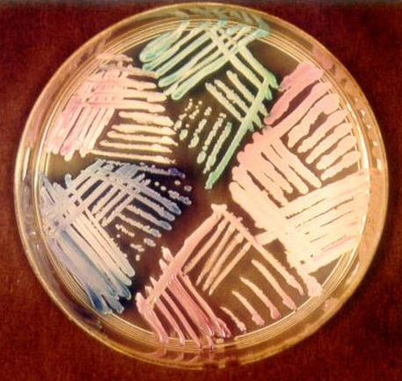
Candida species in Nature
Medically significant Candida species
  C albicans (50- 60%)
  Candida glabrata (15-20%)
  C parapsilosis (10-20%)
  Candida tropicalis (6-12%)
  Candida krusei (1-3%)
  Candida kefyr (<5%)
  Candida guilliermondi (<5%)
  Candida lusitaniae (<5%)
  Candida dubliniensis, primarily HIV
Clin Infect Dis. 2006;43:S15-S27.

Slide 58
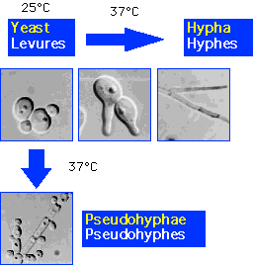
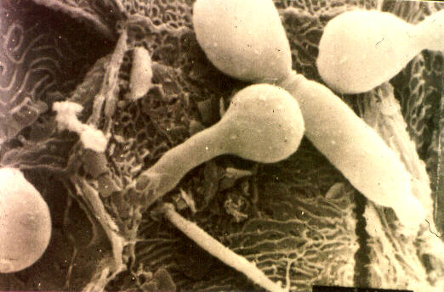
Candida the shape twister (Dimorphic)
Yeast
Hypha
Pseudohyphae

Slide 59
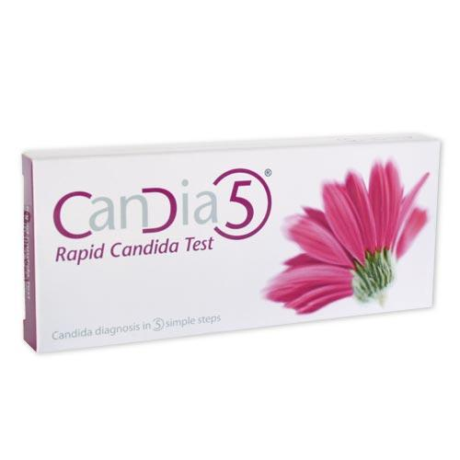
Diagnosis of Candida albicans
PPV = 95% ??????

Slide 60
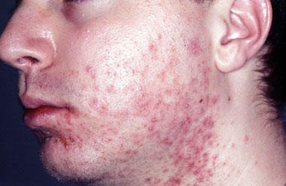
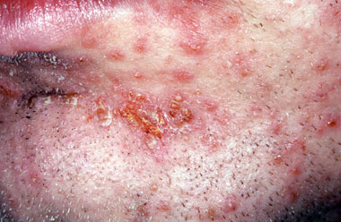
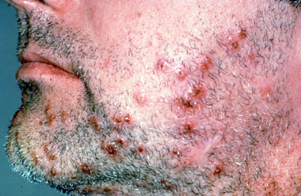
Folliculitis
S aureus
P aeruginosa
Candida species

Slide 61
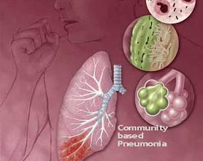
Pneumonia

Slide 62
Pneumonia
The etiology of pulmonary infections in elderly individuals is somewhat different from that in younger adults
  Respiratory syncytial virus (RSV)
  Influenza virus
  Chlamydophila pneumoniae
Most common organisms are:
  Streptococcus pneumoniae
  Haemophilus influenzae

Slide 63
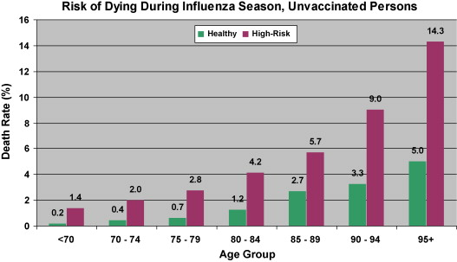

Slide 64
Pneumonia – clinical presentation
Clinical presentation of pneumonia is usually muted
  Temperatures of patients with bacteremic pneumococcal pneumonia are lower to absent
  Cough may be absent
Very elderly patients (>80 years) are more likely to be:
  Afebrile
  Changed mental status
Less likely to complain of:
  Pleuritic chest pain
  Headache
  Myalgia

Slide 65
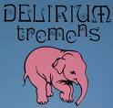
Dilirium - acronym
V ascular
I nfections
T rouma
A utoimmun
M etabolic
I atrogenic
N eoplastic
S iezures

Slide 66
Approach to the elder patient
Culture the blood and sputum of elderly patients
  Bronchoalveolar lavage or by use of a covered brush
Invasive procedures are reserved for uncommon bacterial pathogens

Slide 67
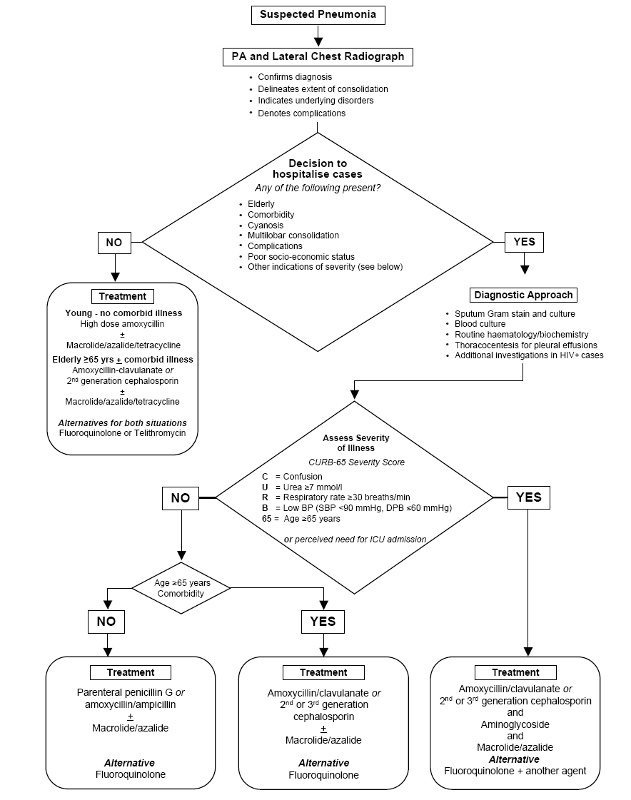
Community acquired Pneumonia

Slide 68
Community acquired Pneumonia

Slide 69
Nosocomial pneumonia treatment
Hospitalised elder patients (> 65 ) developed pneumonia twice as often as younger patients
Risk factors for nosocomial pneumonia included
  Poor nutrition
  Endotracheal intubation
  Neuromuscular disease
Mortality of patients with respiratory disease in intensive care units
  Age (effect)
  Co-morbid conditions

Slide 70
Nosocomial treatment
Initial broad-spectrum coverage that includes P. aeruginosa cover
  Carbapenem
  Broad-spectrum β-lactam plus an aminoglycoside
Broad-spectrum quinolones are promising agents for nursing home-acquired pneumonia

Slide 71
Prevention of pneumonia
Studies demonstrated substantial decline in the incidence of both
  hospitalization and death
    After immunization with the pneumococcal polysaccharide vaccine
    Influenza vaccine
Prophylaxis for influenza

Slide 72
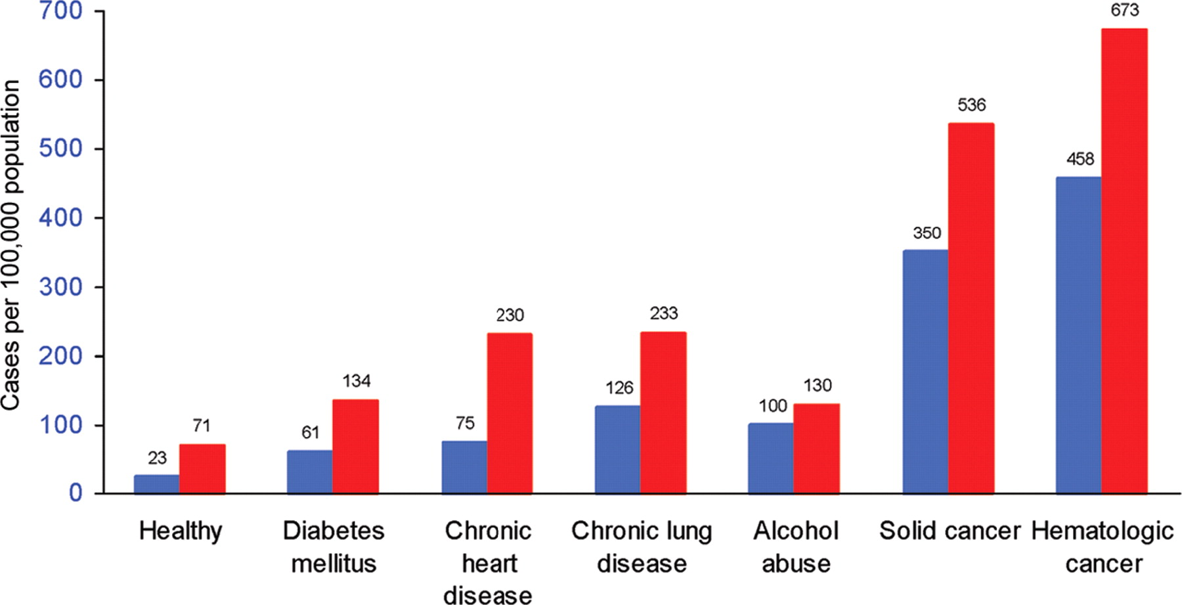
Risk of invasive pneumococcal disease in elderly adults, by age group and chronic illness category
Risk of invasive pneumococcal disease in elderly adults, by age group and chronic illness category. Blue bars, aged 65–79 years; red bars, aged +80 years.
Plotkin S et al. Clin Infect Dis. 2008;47:1328-1338
© 2008 by the Infectious Diseases Society of America
Notes:
Risk of invasive pneumococcal disease in elderly adults, by age group and chronic illness category. Blue bars, aged 65–79 years; red bars, aged ⩾80 years. Figure adapted from Kyaw et al. [22].

Slide 73
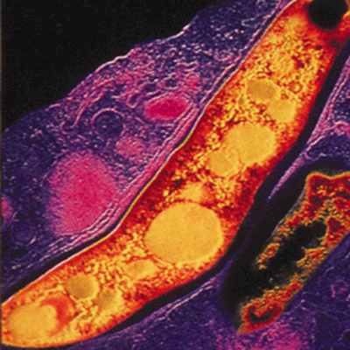
Tuberculosis in the elderly

Slide 74
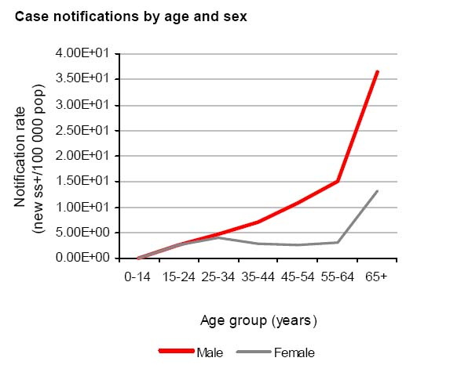
TB notification in the elderly

Slide 75
Death rates in South Africa
Number
TAC Electronic Newsletter June 2006

Slide 76
Tuberculosis in the elderly
The key to diagnosing tuberculosis in the elderly is to maintain a high index of suspicion
In the elderly symptoms may be atypical
  Fever, weight loss, night sweats, sputum production, and hemoptysis were all significantly less common
  Three of four elderly patients with tuberculosis have pulmonary involvement

Slide 77
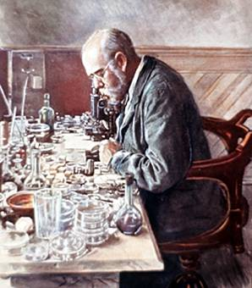
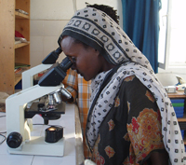
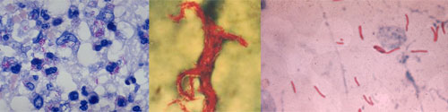
Microscopy (125 years)

Slide 78
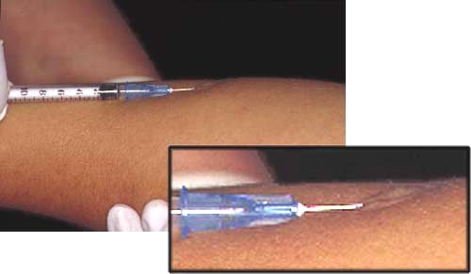
Tuberculin skin test

Slide 79
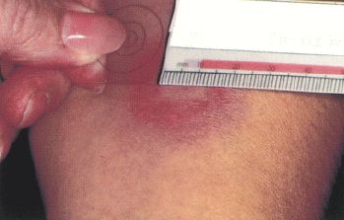
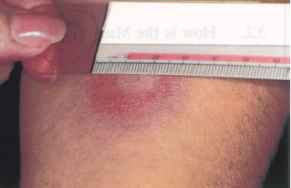
CORRECT
Only the induration is being measured.
INCORRECT
The erythema is being measured.
(CDC 1995)

Slide 80
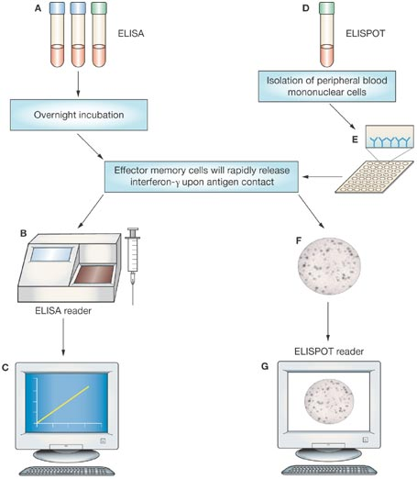
Interferon gamma release assays
Isolation of white blood cells
Overnight incubation
Effector memory cells
release Interferon gamma
Quantiferon
Gold asssay
TB spot
test
Interferon gamma
Detection
Spot counter

Slide 81
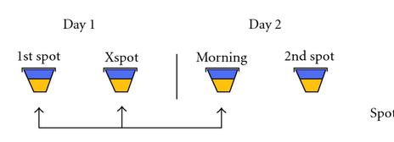
2 sputum's taken early morning
Front-loaded microscopy
Day 1
Day 2
Morning sputum
Morning sputum

Slide 82
Front-loaded microscopy
Day 1
Advantage
Advantage:
Convenience same day sampling
Morning sputum
1h sputum
Limitations :
The technique does not improve
Poor sensitivity of microscopy
2 sputum's taken 1 hour apart, but on the same day

Slide 83
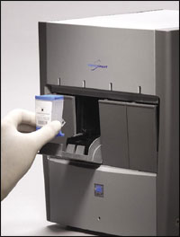
Gene Xpert MTB/RIF (NAAT)
Advantages:
  Can be used on raw samples
  Results in 2 hours
  Closed system (biosafety)
  High sensitivity/specificity
  Multi-disease platform
  Rifampicin resistance testing
Limitations
  Needs electricity
  Outset costs expensive

Slide 84
Prevention of TB (Isoniazid)
IPT is not indicated for an elderly individual who has a history of a positive tuberculin test and no other risk factors
Preventive therapy should be the same as for younger individuals: administration of isoniazid at 5mg/kg/d once daily for ? 6 months???????

Slide 85

Pressure sores and skin infections

Slide 86
Pressure sores
In a study in nearly 20,000 nursing home patients, the prevalence of pressure sores was 10.4% after a 1-year stay in a nursing home
Pressure sores occur primarily in individuals with
  Impaired mobility
  Cause is skin necrosis resulting from ischemia
    Local infection
    Cellulitis of surrounding tissue
    Osteomyelitis

Slide 87
Pressure sores
Assessment and prevention
  Monitor patients who are at risk
  Reducing exposure of the skin to pressure
  Maintaining the skin in a clean and dry condition
  Promote good nutritional status
Therapy of pressure ulcers
  Pressure relief
  Appropriate nutrition
  Debridement

Slide 88
Treatment of pressure sores
Topical treatments
  Povidone-iodine
  Hydrogen peroxide
  Topical antimicrobial agents have not been shown to be effective
  Systemic antibiotic therapy should be reserved for infected ulcers

Slide 89
Bacteremia in pressure sores
Aerobes that are commonly recovered include
  Staphylococci
  Enterococci
  Proteus mirabilis
  E. coli
  Pseudomonas spp
Anaerobic
  Peptostreptococcus
  Bacteroides fragilis
  Clostridium spp.

Slide 90

Bacteremia

Slide 91

Bacteremia

Slide 92
Source of Bacteremia
  Urinary tract
  Intra-abdominal sites
  Respiratory tract
Organisms most commonly recovered from patients with bacteremia associated with skin sources are
  S. aureus
  Staphylococcus epidermidis
  Gram-negative enteric bacteria
  Anaerobes

Slide 93
Increased incidence of Infective Endocarditis
More than 50% of patients were 60 or more years of age
Incidence of endocarditis seems to be related to:
  Prolonged survival of patients with cardiac valvular disease
  Use of prosthetic heart valves
  Intravascular monitoring devices
  Surgically implanted materials

Slide 94
Diagnosis of Infective Endocarditis
Presenting signs and symptoms are nonspecific
  Weakness
  Malaise
  weight loss
  Confusion
Peripheral vascular signs and splenomegaly are both less common in the elderly than in younger patients

Slide 95
Treatment
Empirical therapy is needed for patients with presumed endocarditis who appear to be seriously ill
Initial therapy consists of
  vancomycin and gentamicin
Subsequently, therapy should be guided by results of blood culture and antibiotic susceptibility tests

Slide 96

“Our lives are defined by opportunities, even the ones we miss.”
Eric Roth, The Curious Case of Benjamin Button

