Slide 1
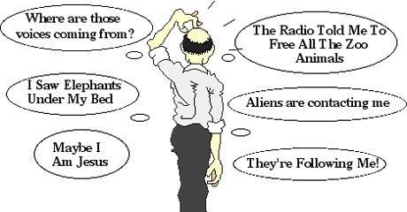
Other psychotic disorders
Dr C Kotzé

Slide 2
Classification
Schizophrenia
Schizophreniform disorder (1 – 6 months)
Brief psychotic disorder (1 day – 1 month)
Schizoaffective disorder
Bipolar type - Depressive type
Delusional disorder
Erotomanic type - Grandiose type
Jealous type - Persecutory type
Somatic type - Mixed type
Unspecified type
Shared psychotic disorder
Psychotic disorder NOS
Psychotic disorder due to a GMC
Substance induced psychotic disorder

Slide 3
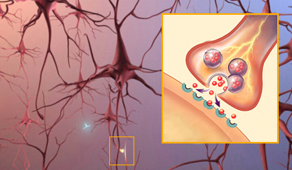
Schizophreniform disorder
Similar to schizophrenia except for duration
> 1 month but < 6 months
Outcome
Return to baseline level of functioning
Continue > 6 months and become schizophrenia
Most common in adolescents and young adults
Lifetime prevalence of 0.2%

Slide 4
Brief psychotic disorder
An acute and transient psychotic syndrome
1 day to 1 month
May resemble schizophrenia
May develop in response to a severe stressor
Uncommon disorder
More in younger patients and women
50% later display chronic psychiatric Sx

Slide 5
Schizoaffective disorder
Uninterrupted period of illness with
MDE/ manic episode/ mixed episode
Concurrent with criteria A for schizophrenia (delusions, hallucinations, disorganized speech, disorganized / catatonic behavior, negative Sx)
Period of delusions & hallucinations for 2 weeks in absence of prominent mood Sx
Mood episode present for substantial portion of total duration of the illness
Not due to substances / GMC

Slide 6
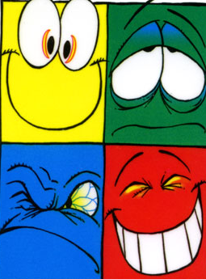
Schizoaffective disorder
Bipolar type / depressive type
0.5-0.8% lifetime prevalence
Mood component should be present 20% of the total duration of the illness
Prognosis depends on whether the predominant symptoms were mood / psychotic Sx
Treat both mood and psychotic symptoms
Notes:
2 month manic episode in person who have suffered from schizophrenia for 10 years does not meet the criteria for SAD.
Diagnosis would rather be a mood episode superimposed on schizophrenia.

Slide 7
Delusional disorder
Non-bizarre delusions for >1/12
Criteria A for schizophrenia never met
Functioning not markedly impaired and behaviour is not odd or bizarre
If mood episodes have occurred with delusions, their total duration has been relatively brief
Not due to substance / GMC
Notes:
Non-bizarre means that the delusions must be about situations that can occur in real life, such as being followed, infected, loved at a distance etc.
Usually to do with phenomena that are possible, although it is not real.

Slide 8
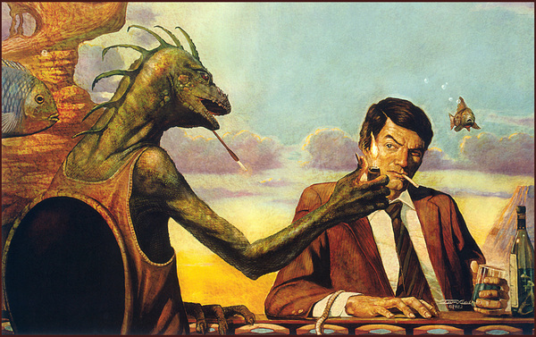
Types of delusions
Delusional jealousy
Grandiose
Persecutory
Somatic
Of being controlled
Bizarre: Totally implausible
Of reference
Erotomanic
Nihilistic: Oneself, part of one’s body, or the real world does not exist or has been destroyed
Thought broadcasting / insertion

Slide 9
Delusions
Mood-congruent
Content consistent with mood
Depressed = themes of personal inadequacy, guilt, disease, death, punishment, nihilism
Manic = inflated worth/ power/ knowledge, special relationship with deity/famous person
Mood-incongruent
Content not consistent with mood
Persecutory delusions, thought insertion/ broadcasting, delusions of being controlled

Slide 10
Delusional disorder types
Erotomanic type
Grandiose type
Jealous type
Persecutory type
Somatic type (foul odour / halitosis, infestation, dysmorphophobia,)
Mixed type
Unspecified type (Capgras’s, Fregoli’s, intermetamorphosis)
Notes:
Persecutory type and Jealous type the most common.
Jealous type more common in men and have been associated with violence.
Erotomanic type more common in women. Interpret any denial of love as secret affirmations. Often stalks and also associated with violence.
Capgras’s = familiar person replaced by imposter
Fregoli’s = familiar person can assume the guise of strangers
Intermetamorphosis = familiar person can change into other persons at will

Slide 11
Clinical features
Well groomed
No gross disintegration of daily activities
Seem eccentric, odd, suspicious or hostile
MSE normal except for delusions
Mood is consistent with content of delusions
No prominent hallucinations
Delusions usually systematized
Memory and cognitive processes are intact
No insight
Notes:
Tactile or olfactory hallucinations may be present if they are related to the delusions (e.g. Somatic delusion of body odour)

Slide 12
Shared psychotic disorder
Characterized by transfer of delusions from one person to another
Closely related for a long time
Typically one ill person influences a suggestible person
2nd is usually less intelligent, more gullible and passive with poor self-esteem
If separated the 2nd abandons the delusion

Slide 13
Culture bound syndromes
Culturally based signs & symptoms of mental distress / maladaptive behaviour
Informed by native cultural assumptions, sorcery, breach of taboo, intrusion of a disease object / disease causing spirit, or loss of soul
Amok: Dissociative episode with aggression precipitated by perceived insult accompanied by amnesia and persecutory ideas

Slide 14
Culture-bound syndromes
Important to determine if symptoms represents a culturally appropriate response to a situation
Get collateral info & follow up over time

Slide 15
Psychotic disorder due to GMC
Prominent hallucinations / delusions
Direct physiological consequence of GMC
Not during delirium
Occipital and temporal pathology can cause hallucinations
Temporal lobe and parietal lobe, especially R hemisphere pathology associated with delusions

Slide 16
Substance induced psychotic disorder
Not diagnosed if insight that hallucinations are caused by substances
Common causes:
cannabis, alcohol, LSD, amphetamine,
cocaine, PCP, ketamine, steroids, thyroxine
Not substance induced if symptoms precedes substance use / persists for >1month after cessation / substantially in excess of what would be expected
Notes:
Diagnosed instead of withdrawal / intoxication when symptoms are in excess of those usually associated with substance and severe enough to warrant independent clinical attention.

Slide 17
Psychotic disorder NOS
Psychotic Sx with inadequate information to make specific diagnosis / do not meet criteria for specific disorder
Postpartum psychosis
Auditory hallucinations in absence of other features
Unable to determine if it is due to GMC / substance

Slide 18
Good prognostic factors
Acute onset
Precipitated by stressors
Later age of onset
Prominent mood component
No family history of schizophrenia
Stable premorbid personality
Consistent social support
Short duration of symptoms
Little affective blunting

Slide 19
Differential diagnosis
GMC / Substance induced
Intoxication / withdrawal from substances
Delirium
Different psychotic disorders
Culture specific disorders
Mood disorders with psychotic features

Slide 20
General management
Make a specific diagnosis
If substances is involved treatment can be postponed for 5-7 days
Start on low dose anti-psychotic
Duration of treatment will depend on diagnosis
Follow up regularly
Monitor for side effects, compliance & efficacy

