Slide 1
PARKISON DISEASE
UNDERGRADUATES(SIC)
Dr M.Tsikane
Neurology

Slide 2
Background
Idiopathic Parkinson Disease (is a --progressive neurodegenerative disorder associated with decrease dopamine in sustantia nigra.
Affecting about 0.4% people>40y
1% people>65y
10%people>80y
Cardinal features: Resting tremor, Rigidity, Bradykinesia, and postural instability.

Slide 3
Background (…
Prevalence: 120 per 100,000
Sex: M/F =1.5/1
Age: incidence and prevalence increase with age. average age of onset is approximately 57 years
Etiology of Idiopathic PD: interplay of
Genetic; several genetic form of the disease have been identified.
Environmental factors; toxins (e.g,pestisides), oxidative stress and viral infections.

Slide 4
Pathophysiology
The major neuropathologic findings in Parkinson disease are:
a loss of Pigmented dopaminergic neurons in the substantia nigra (approximately 60-80% are lost before the motor signs of Parkinson disease emerge)
the presence of synuclein-filled Lewy bodies within the pigmented neurons of the substantia nigra (Lewy bodies also are found in The other parts of the CNS, are not specific to parkinson disease, the prevalence of incidental Lewy bodies increases with age and are hypothesized to represent the presymptomatic phase of parkinson disease.)
No standard criteria exist for the neuropathologic diagnosis of parkinson disease so far.

Slide 5
Pathophysiology (…
Lewy body pathology in parkinson disease begins; in the olfactory bulb and lower brainstem (associated with premotor symptoms such as loss of sense of smell and rapid eye movement (REM) sleep behavior disorder)
Pathology ascends up to the brain stem to involve the midbrain and nigrostriatal dopaminergic neurons (correlate with onset of motor phase of disease; Bradykinesia, rigidity, and tremor).
Pathology continue s to ascend late in the disease to affect the cortex ( patient may exhibit cognitive dysfunction and dementia.)

Slide 6
Pathophysiology (Motor circuit in Parkinson disease
The basal ganglia motor circuit modulates cortical output necessary for normal movement.
Signals from the cerebral cortex are processed through the basal ganglia-thalamocortical motor circuit and return to the same area via a feedback pathway.
In Parkinson disease, decreased striatal dopamine causes increased inhibitory output from basal ganglia which suppresses movement

Slide 7
Symptoms and signs
Premotor phase:
Initial symptoms may be nonspecific; fatigue, depression, Constipation, decreased sense of smell and sleep problem, daytime sleepiness, REM behavior disorder (RBD) , in one study,38% of 50y/o men with RBD and no neurological signs went on to develop parkinsonism.
Motor signs:
A subtle decrease in dexterity, Difficulty with specific tasks; turning in bed, opening jars, rising from a chair, a lack of coordination with activities such as playing golf or dressing, complain of aching or tightness in the calf or shoulder region, the first affected arm may not swing fully when walking, and the foot on the same side may scrape the floor.

Slide 8
Symptoms and signs(...
A resting tremor of one hand is often the first symptom. The tremor is characterized as follows:
• Slow and coarse
• Maximal at rest, lessening during movement, and absent during sleep
• Amplitude increased by emotional tension or fatigue
• Often involving the wrist and fingers in movements similar to those used to manipulate small objects or pills (pill-rolling tremor)
Usually, the hands, arms, and legs are most affected, in that order. The jaw, tongue, forehead, and eyelids may also be affected, but not the voice. Tremor may become less prominent as the disease progresses.

Slide 9
Symptoms and signs(…
Rigidity develops without tremor in many patients. When a clinician moves a rigid joint, sudden, rhythmic jerks due to variations in the intensity of the rigidity occur, producing a ratchet-like effect (cogwheel rigidity).

Slide 10
Symptoms and signs(…
Slow movements (bradykinesia) are typical as rigidity progresses. Movement also becomes decreased (hypokinesia) and difficult to initiate (akinesia).
Rigidity and hypokinesia may contribute to;
muscular aches and sensations of fatigue.
masklike face , with an open mouth, drooling, and reduced blinking.
patients may appear depressed due to masklike face and bradykinesia.
Speech becomes hypophonic, with characteristic monotonous, stuttering dysarthria.
micrographia (writing in very small letters) due to hypokinesia and impaired control of distal musculature ( that make activities of daily living increasingly difficult).
Without warning, voluntary movement, including walking, may suddenly halt (called freezing).

Slide 11
Symptoms and signs(…
Postural instability develops, resulting in gait abnormalities. Patients have difficulty starting to walk, turning, and stopping; the gait becomes shuffling with short steps, and the arms are held flexed to the waist and do not swing with the stride. Steps may inadvertently quicken, and patients may break into a run to keep from falling (festination). A tendency to fall forward (propulsion) or backward (retropulsion) when the center of gravity is displaced results from loss of postural reflexes. Posture becomes stooped.

Slide 12
Symptoms and signs(…
Dementia; generally occurs late in the disease and affects 15-30% of patients. short term memory and visuospatial function may be impaired, but aphasia is not present.
Cognitive dysfunction within a year of onset of motor features suggests a diagnosis of Lewy body disease, a disease closely related to parkinson disease and marked by the presence of cortical Lewy bodies

Slide 13
Symptoms and signs(…
Neurologic symptoms unrelated to parkinsonism commonly develop because synucleinopathy (Lewy bodies) occurs in other areas of the central, peripheral, and autonomic nervous systems. It may have the following effects:
• Almost universal sympathetic denervation of the heart, contributing to orthostatic hypotension
• Esophageal dysmotility, contributing to dysphagia and increased risk of aspiration
• Lower bowel dysmotility, contributing to constipation
• Commonly, anosmia and urinary hesitancy and/or
urgency.
Seborrheic dermatitis is also common.

Slide 14
Differential diagnosis of Parkinsonism
(General classification)
1-Idiopathic PD
2-Atypical PD
3- Essential Tremor (ET)

Slide 15
DDX (detailed classification…
2-Atypical PD
Neurodegenerative disorders other than idiopathic PD, including dementia with Lewy bodies, corticobasal degeneration, multiple system atrophy, progressive supranuclear palsy.
Secondary parkinsonism; a wide variety of conditions can cause secondary parkinsonism, including;
Drugs( classic and atypical antipsychotic agents, haloperidol, pimozide, chlorpromazine, droperidole, fluphenazine, trifluoperazine, Metoclopramide, domperidone, flunarizine, , Reserpine prochlorperazine, illegal or street drugs)
Toxins ; carbon disulfide, carbon monoxide, cyanide, MPTP, manganese, organic solvants.

Slide 16
DDX (detailed classification…
Head trauma; isolated or repeated (e.g., boxing)
Structural brain lesions that affect striatonigral circuits, e.g, Hydrocephalus, chronic subdural hematoma, tumors
Metabolic and miscellaneous disorders (e.g, wilson disease, hypoparathyroidism and psudohypoparathyroidism, chronic liver failure, extrapontine myelinilysis, neurodegeneration with brain iron accumulation, neuroacanthocytosis.)
Infections; encephalitis lethargica or economo’s encephalitis, HIV/AIDS, neurosyphilis, prion disease, progressive multifocal leukoencephalopathy, toxoplasmosis.

Slide 17
DDX (detailed classification…
Small vessel disease; vascular parkinsonism, multiple lacunar infarcts in the basal ganglia and /or Binswanger’s disease ( this entity is controversial, because most basal ganglia infarcts are not associated with parkinsonian signs.)

Slide 18
Diagnosis …
Diagnosis is based on HX and PE
Neuroimaging (CT,MRI) may be used to R/O other abnormalities , thus help identify secondary causes of parkinsonism.
Response to levodopa treatment; Idiopathic PD usually have a good response, comparing to atypical PD who have a poor and transient response. also they show a higher incidence of side effects to anti parkinson medications ( particularly confusion, agitation, and hallucinations)

Slide 19
Diagnosis …
The major differences between atypical and idiopathic PD
Absence of resting tremor
Earlier onset and more rapid progression to gait disorder and postural instability
Rigidity that is greater in the trunk than the limbs (axial rigidity) or is very severe
Early onset of falls, dementia, dysphagia, or autonomic instability (e.g., dizziness associated with postural hypotension; urinary retention and incontinence; constipation; impotence; impaired thermoregulation; sweating)
Poor, transient, or absent motor symptom response to levodopa

Slide 20
DDX …
Dementia with Lewy bodies: second most common neurodegenerative after Alzheimer disease, characterized clinically by vivid visual hallucinations, flactuating cognition, and parkinsonism. Also repeated falls, syncope, autonomic dysfunction, neuroleptic sensitivity, deleusions, hallucinations in nonvisual modalities, sleep disorders, depression.
40% of patients with parkinson disease develop dementia late in the disease in the setting of well established parkinsonism, while in DLB dementia usually occurs concomitantly with or before the development of parkinsonian signs.
Treatment: cholinesterase inhibitors (e.g., AriceptB, ExelonB, etc.)

Slide 21
DDX …
Corticobasal degeneration; apraxia, cortical sensory signs, myoclonus , dystonia, unilateral presentation.
Multiple system atrophy; postural hypotension;
autonomic dysfunction (including bladder
instability); cerebellar dysfunction (e.g., ataxia,
hypotonia, tremor with intention or sustention);
neck flexion; myoclonus; dysarthria; seborrhea
Treatment: measures to control or reduce blood pressure-e.g. reduced salt intake, support stockings ,midodrine (AmatineB)

Slide 22
DDX …
Progressive supranuclear palsy: oculomotor dysfunction (impaired vertical eye movement especially down gaze); dysarthria and dysphagia due to spastic weakness of pharyngeal muscles (pseudobulbar palsy); early falls; axial rigidity (neck and spine more than legs). Treatment : physical therapy; vision aids
Vascular parkinsonism: pyramidal signs, such as
weakness or paralysis (predominantly of distal
voluntary movement); spasticity (increased
muscle tone and exaggerated deep tendon
reflexes, resulting in "knife-clasp" rigidity).
treatment: control of risk factors (e.g., diabetes, hyperlipidemia,
hypertension); secondary stroke prevention with acetylsalicylic acid

Slide 23
Management
Parkinson disease (PD) is a chronic disorder that requires broad-based management including patient and family education, support group services, general wellness maintenance, exercise, and nutrition. Treatment of PD can be divided into :
pharmacologic
Non-pharmacologic
surgical therapy.

Slide 24
Management (cont..)
Pharmacologic treatment of Parkinson disease
The major drugs available for symptomatic therapy include:
Levodopa
MAO B inhibitors
Dopamine agonists
COMT inhibitors
Anticholinergic agents
Amantadine

Slide 25
Management (cont..)
Pharmacologic treatment of Parkinson disease
Generic name Trade name Usual starting dose Usual maintenance dose Mechanism
Trihexyphenidyl Artane 1 mg BID 2 mg BID-TID Anticholinergic
Benztropine Cogentin 0.5 mg BID 1 to 2 mg BID-TID Anticholinergic
Amantadine Symmetrel 100 mg BID 100 mg BID-TID ?
Selegiline Eldepryl 5 mg 5 mg q am MAO B inhibitor
Carbidopa/levodopa Sinemet 25/100 mg TID 25/250 mg TID-QID Dopamine precursor
Carbidopa/levodopa Sinemet CR 25/100 mg TID 50/200 mg TID Dopamine precursor
Apomorphine Apokyn 2 mg SC test dose 2 to 10 mg SC TID Dopamine agonist
Bromocriptine Parlodel 2.5 mg daily 5 to 10 mg QID Dopamine agonist
Pergolide Permax 0.05 mg daily 0.5 to 1.0 mg TID Dopamine agonist
Pramipexole Mirapex 0.125 mg TID 1.5 mg TID Dopamine agonist
Ropinirole Requip 0.25 mg TID 1.0 mg TID Dopamine agonist
Entacapone Comtan 200 mg with L-dopa 600 to 800 mg a day COMT inhibitor
Tolcapone Tasmar 100 mg TID 100 to 200 mg TID COMT inhibitor

Slide 26
Management (cont..)
Non-Pharmacologic treatment of Parkinson disease
Education : essential in order to provide the patient and family with some understanding and control over the disorder , available through books written for the lay audience; national and regional Parkinson disease organizations, which publish educational pamphlets and organize symposia for patients and families; and the Internet. A useful central information resource is the "We Move" Foundation at www.wemove.org.
Support : The emotional and psychological needs of the patient and family should be addressed. Normal reactions of anger, depression, anxiety, and social and economic concerns often begin with the onset of the disease and evolve as it progresses. Support for the caregiver is particularly important. Referral of the patient and/or family to a psychologist or psychiatric social worker experienced in dealing with chronic illness may be appropriate in some cases. In other instances, referral for legal, financial, or occupational counseling is indicated.

Slide 27
Management (cont..)
Non-Pharmacologic treatment of Parkinson disease
EXERCISE AND PHYSICAL THERAPY : Exercise will not slow the progression of akinesia, rigidity, or gait disturbance, but it can prevent or alleviate some secondary orthopedic effects of rigidity and flexed posture such as shoulder, hip, and back pain, and it may also improve function in some motor tasks. Brisk walks, swimming, and water aerobic exercises are particularly useful. Referral to a physical therapist or exercise group may be a good way to get patients started in such activities.
Speech therapy : Dysarthria and hypophonia are common manifestations of Parkinson disease (PD).
Nutrition : Elderly patients with chronic illness are at risk for poor nutrition and weight loss. Prompt recognition and management of this problem is important to avoid loss of bone and muscle mass. No specific diet influences the course of Parkinson disease (PD), A high fiber diet and adequate hydration help manage the constipation of PD. Large, high-fat meals that slow gastric emptying and interfere with medication absorption should be avoided. Dietary protein restriction is not necessary except in some patients with advanced disease and motor fluctuations in whom competition with other amino acids interferes with L-dopa absorption.

Slide 28
Management (cont..)
Management of comorbid problems associated with Parkinson dz
patients with PD may experience problems related to the disease itself or to the medications used to treat it. These comorbid problems include psychosis, hallucinations, daytime sleepiness, depression, fatigue and dementia.
PSYCHOSIS AND HALLUCINATIONS : visual hallucinations and delusions, and paranoia. Antiparkinsonian drugs can be reduced or stopped in reverse order of their potency and effectiveness if hallucinations are causing disability; the suggested sequence begins with anticholinergic drugs, followed by amantadine, COMT inhibitors, and, lastly, dopamine agonists. Levodopa is essential for almost all patients with PD.
The atypical neuroleptics clozapine and quetiapine may be helpful in low doses . They do not appear to worsen parkinsonism as do other atypical neuroleptics, such as risperidone and olanzapine, and the typical neuroleptics.
DEMENTIA :
DAYTIME SLEEPINESS : involves efforts to improve nocturnal sleep hygiene and to treat causes of poor nocturnal sleep.

Slide 29
Management (cont..)
Management of comorbid problems associated with Parkinson dz
FATIGUE :
DEPRESSION : No clear first choice for treating depression associated with PD, drug selection should be based on potential advantages versus potential side effects . It seems reasonable to start with an SSRI (sertraline appears to be the safest SSRI for use in PD. ) in most patients, as the likelihood of adverse events is lower than tricyclics such as amitriptyline.
Serotonin syndrome ; avoid co administration on selegiline (MAO B inhibitor) and SSRI’s
Aggravating motor symptoms : SSRI’s may exacerbate the motor symptoms of parkinson disease, mostly associated with FLuxetine and Paroxetine, sertraline has been associated with relatively few cases .

Slide 30
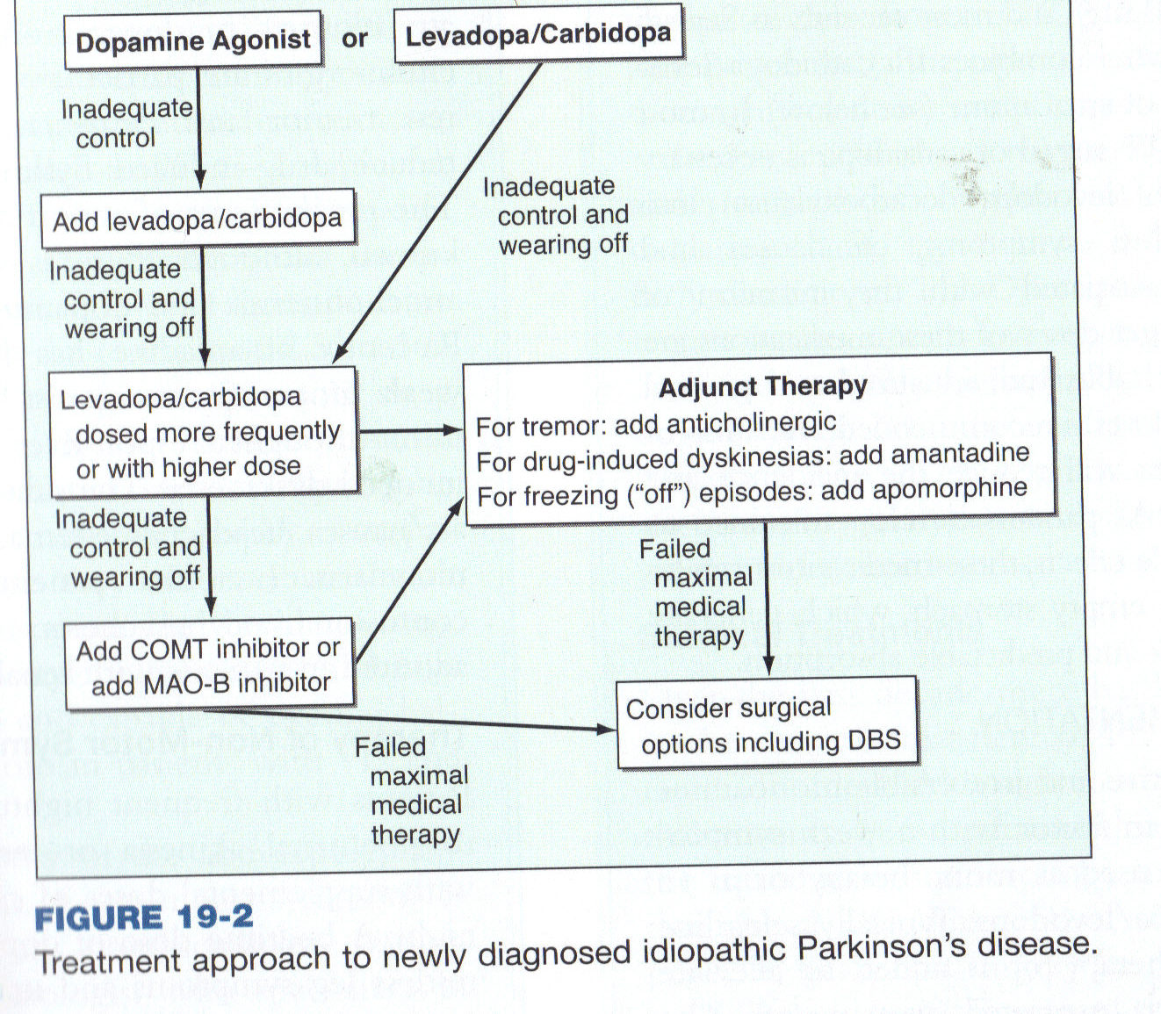

Slide 31
THANK YOU
ALL THE BEST WITH YOUR ASSESMENT/EXAM.

