Slide 1
Shoulder & Elbow dislocations.
H. Sithebe
2012

Slide 2
Shoulder Dislocations.
50% of all joint dislocations.
98% - Anterior.
2% - Posterior.

Slide 3
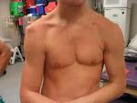
Clinical Presentation.
Anterior dislocation.
Posterior Dislocation.
Abduction.
External rotation.
Rare.
Missed!!.
Adduction.
Internal rotation.

Slide 4
Clinical Assessment.
Neurovascular Exam!!!.
Brachial Plexus.
Axillary Nerve.
Peripheral pulses.

Slide 5
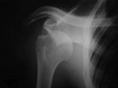
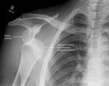
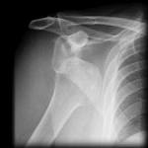
Radiology.

Slide 6
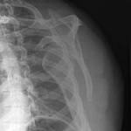
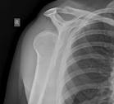
Radiology.
Anterior.
Posterior.

Slide 7
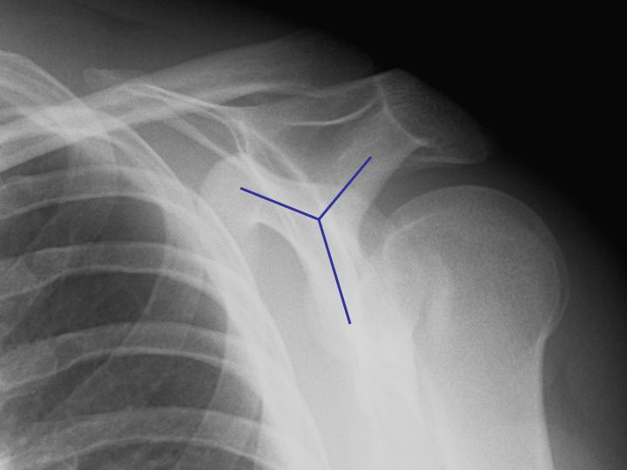

Slide 8
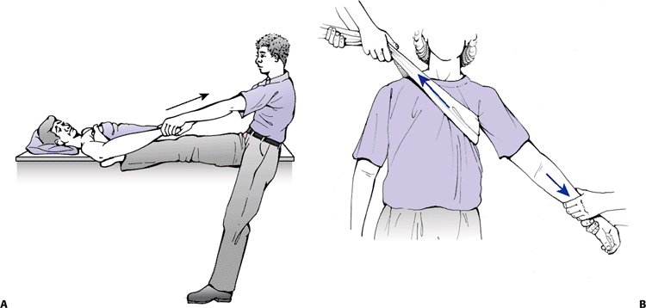
Reduction- Hippocratic manoeuvre

Slide 9
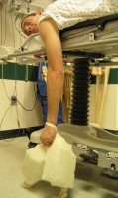
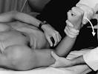
Reduction- Anterior Dislocation.
Stimson.
Kocher.

Slide 10
Complications.
Rotator cuff tear.
Nerve injury.
Vascular injury.
Fracture-dislocation.
Stiffness.
Unreduced dislocation.
Recurrent dislocation.

Slide 11
Elbow Dislocations
Stable Joint.
Simple dislocations.
Complex dislocations.

Slide 12
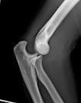
Pathophysiology.
Posterior.
Fall on extended/abducted arm.
Anterior.
Direct blow to Flexed elbow.

Slide 13
Clinical Presentation.
Posterior.
Elbow flexed.
Anterior.
Extended
Neurovascular exam!!!!.

Slide 14
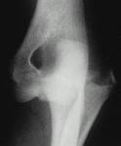
Radiology
AP
Lateral.

Slide 15
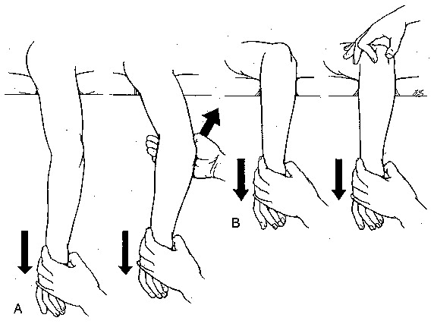
Reduction- posterior dislocation.

Slide 16
Complications.
Vascular injury.(Compartment Sx)
Nerve injury.
Stiffness.
Recurrent dislocation.
OA.

